Slide 1

ASSESSMENT OF URBAN SPATIAL GROWTH FOR TRICHY DISTRICT, TAMINADU,INDIA FOR BETTER SOLID WASTE MANAGEMENT USING GEOSPATIAL TECHNIQUES
Presented by
G.MEENATCHI
Department of remote sensing
Bharathidasan University, Trichy, Tamilnadu, India

Slide 2
CONTENTS
INTRODUCTION
STUDY AREA
METHODOLOGY
ANALYSIS OF URBAN GROWTH USING LULC,
NDVI & NDBI MAPS AND CORELATION STUDIES
SOLID WASTE MANAGEMENT
SUITABLE SITE SELECTION OF LANDFILLS
CONCLUSION

Slide 3
INTRODUCTION
The Industrial expansion, advanced technologies and economic improvement has inspired people to move closer to urban and semi-urban areas in a country.
And also due to over population growth, it has negative impacts on the environment.
So the urban solid waste management is a global environmental problem in today’s world.

Slide 4
AIM AND OBJECTIVE
To study Landuse/Land cover (LULC) changes due to urbanization and related concretization and to correlate it with Land Surface Temperature (LST), Normalized Difference Vegetation Index (NDVI) and Normalized Difference Build-up Index (NDBI) to assess the change detection for the years 1997, 2007and 2019 in Trichy City, Tamilnadu, India.
According to that, the suitable sites for dumping solid waste were proposed using open source (QGIS) GIS software.

Slide 5
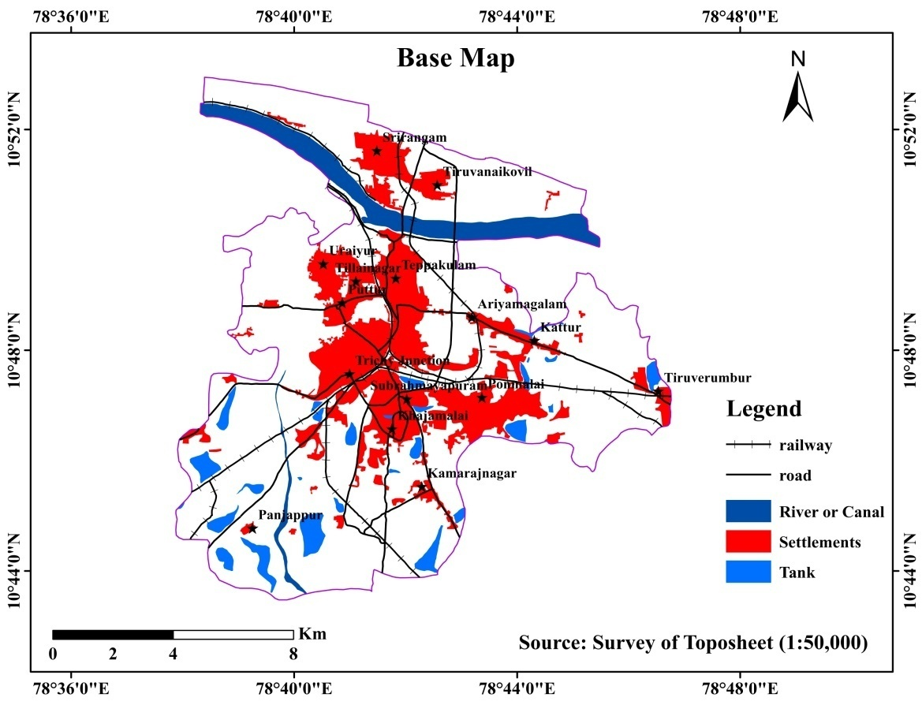
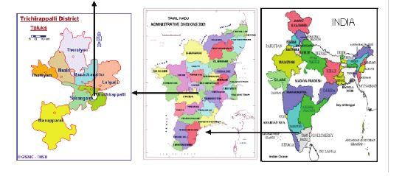
STUDY AREA
Tiruchirapalli famously known as Trichy, is a Swachh Bharat City, is situated in the centre of the state, on the banks of the Cauvery River in the Indian state of Tamil Nadu which is the administrative headquarters of Tiruchirapalli District.
It is the third and fourth largest city by area and population in the state as per census 2011.
Occupying 167.23 square kilometers (64.57 sq. mi), the city was home to 916,857 people in 2011.
Trichy lies in between 10.73644 to 10.89534 North latitudes and 78.615 to 78.762 East longitudes. It has the fourth largest Municipality and urban agglomeration in the state of Tamil Nadu.

Slide 6
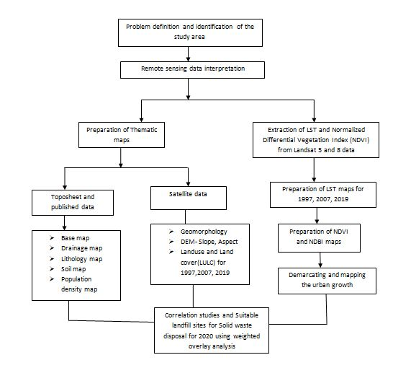
METHODOLOGY & DATA USED
Data | Purpose | Spatial Resolution
Landsat 5(TM) & 8(OLI) | LULC, LST, NDVI NDBI | 30m
SRTM | DEM, Slope, Aspect, Drainage density | 90 m
Toposheet -Road, river and railway buffers | Solid waste management | -

Slide 7
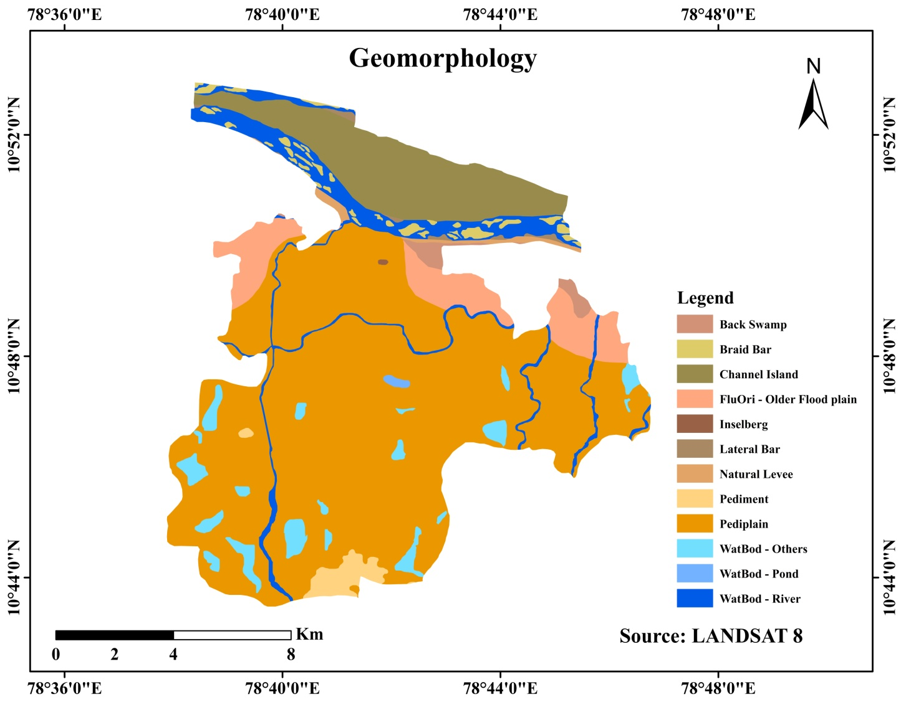
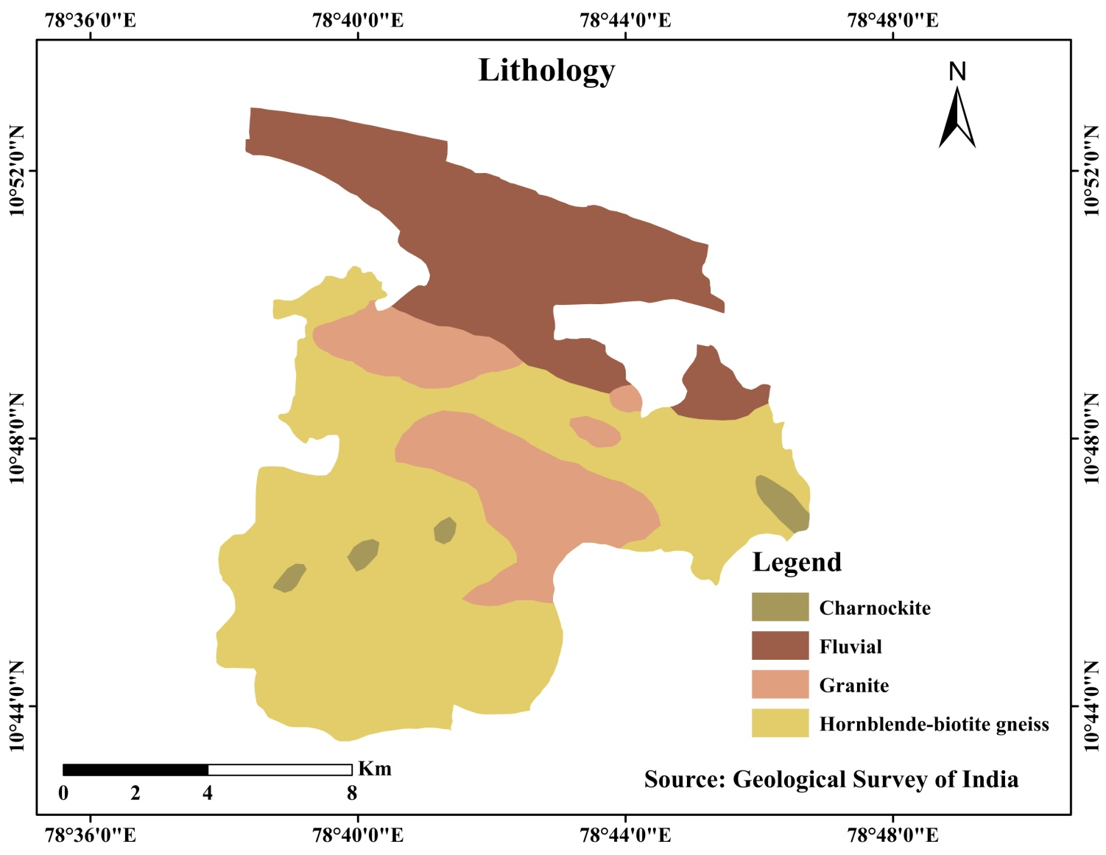
THEMATIC LAYERS

Slide 8
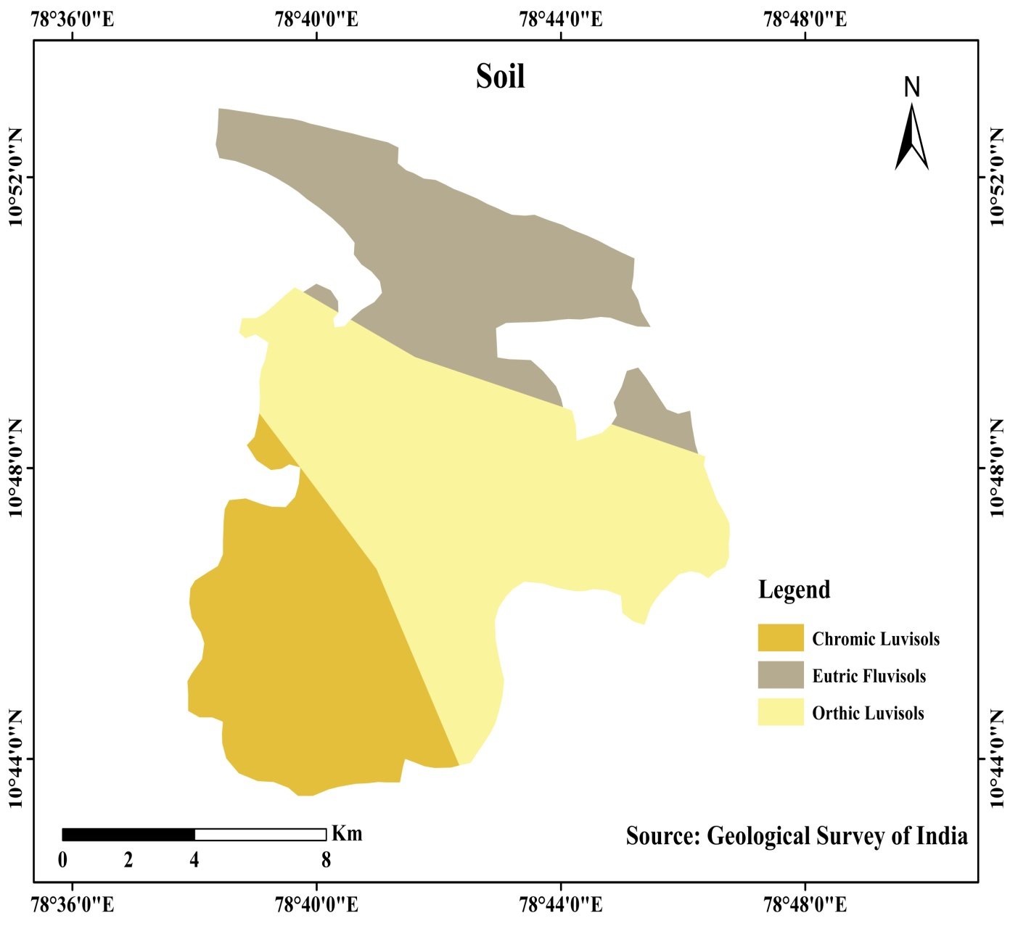
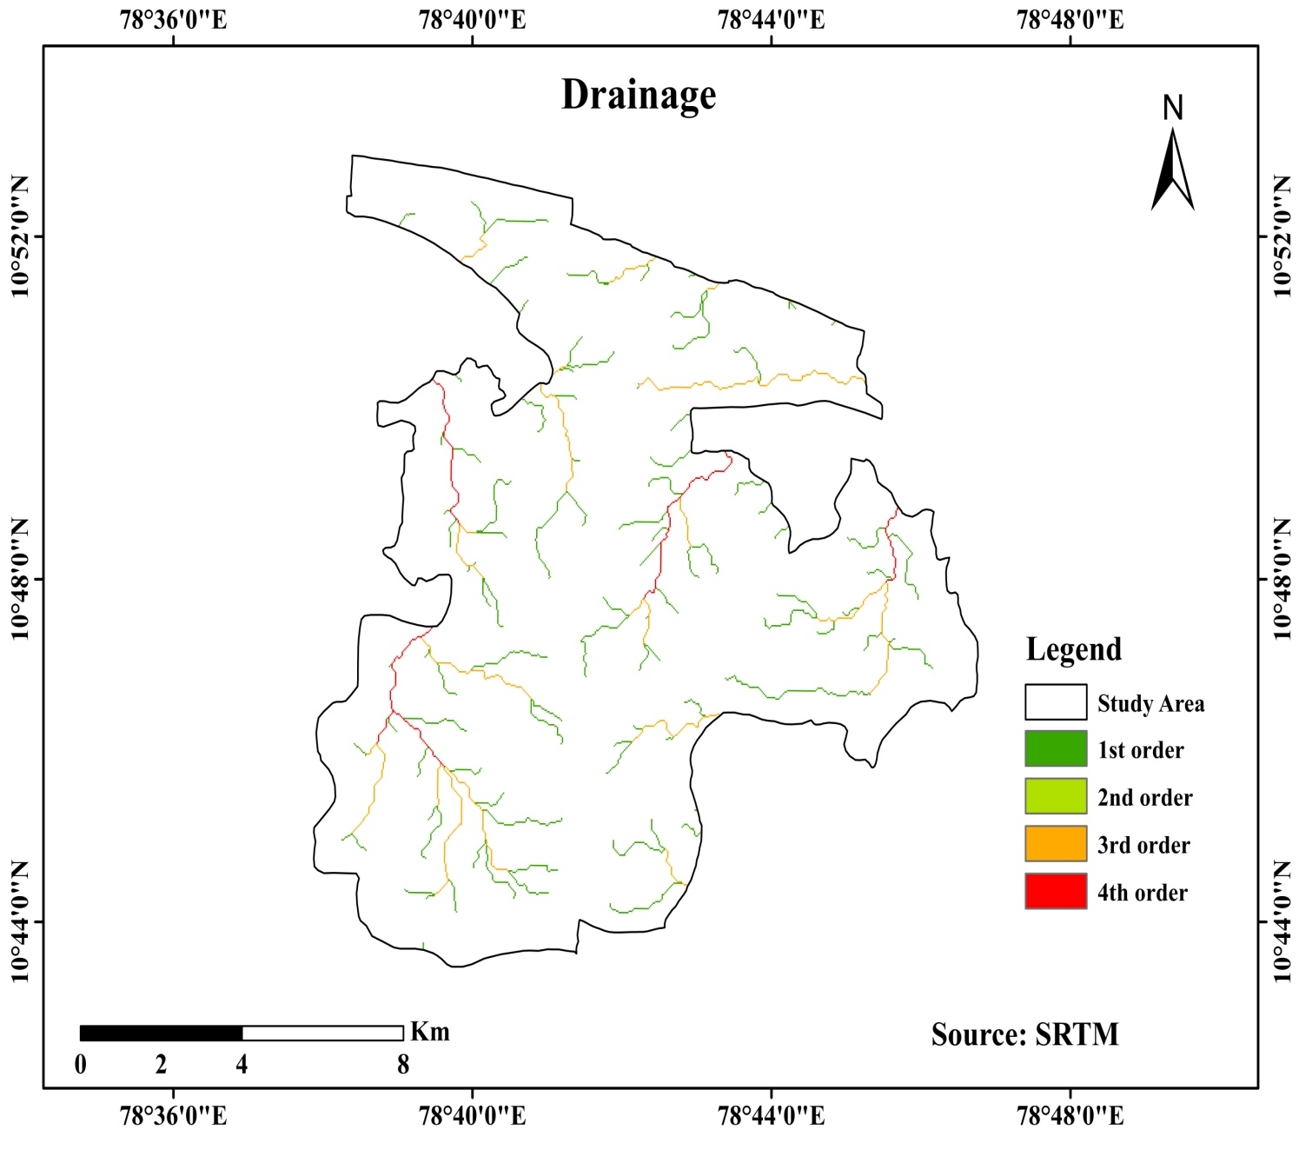

Slide 9
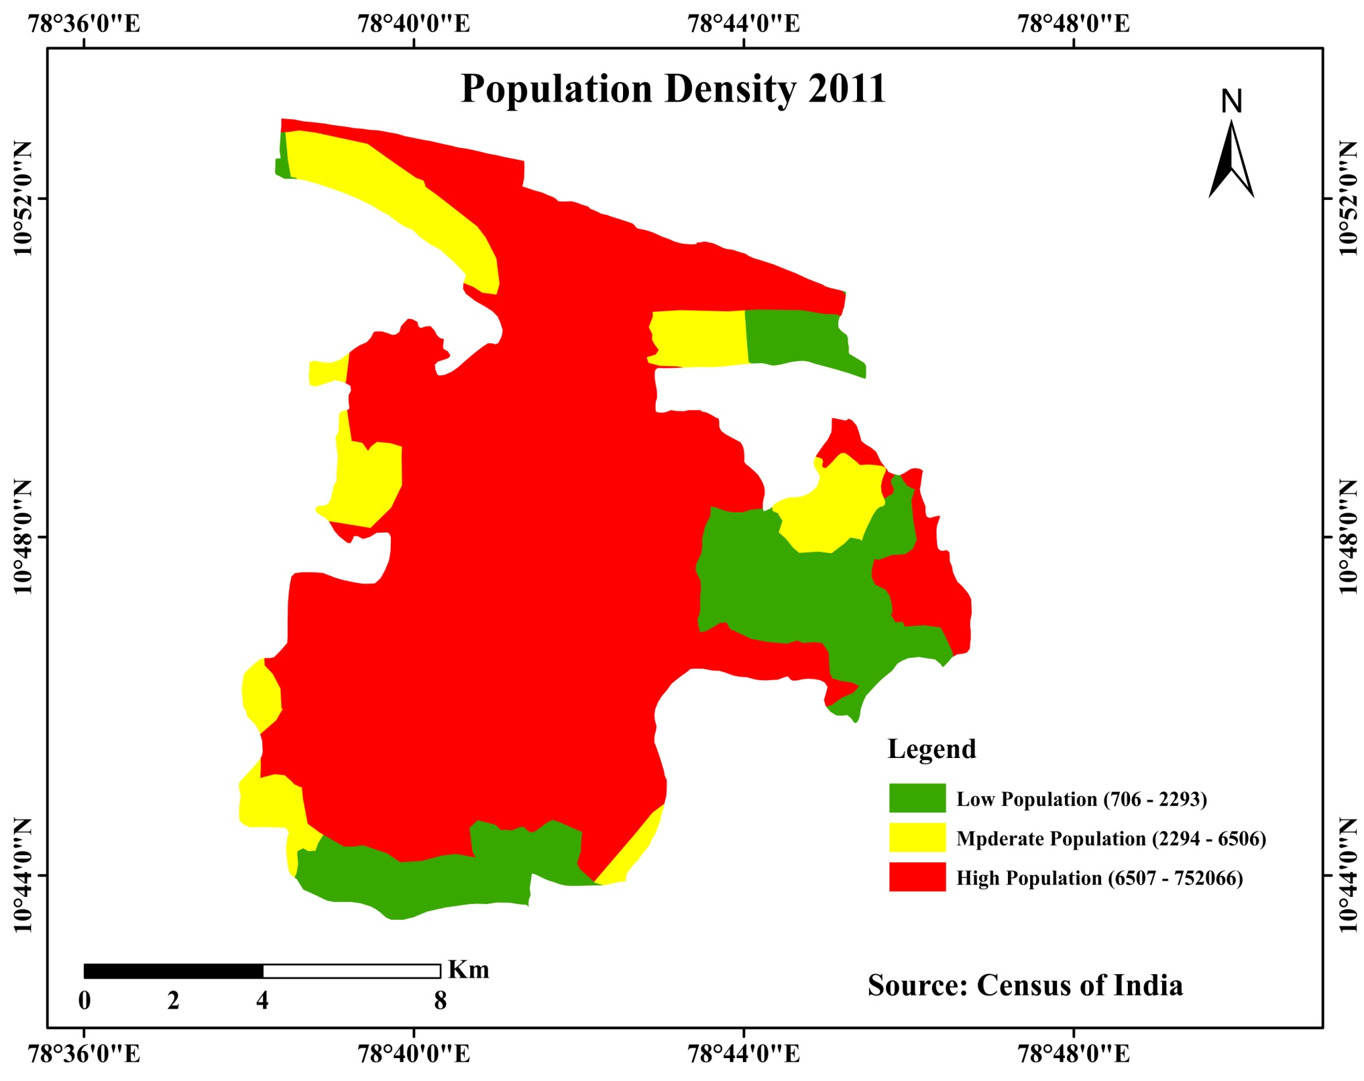

Slide 10
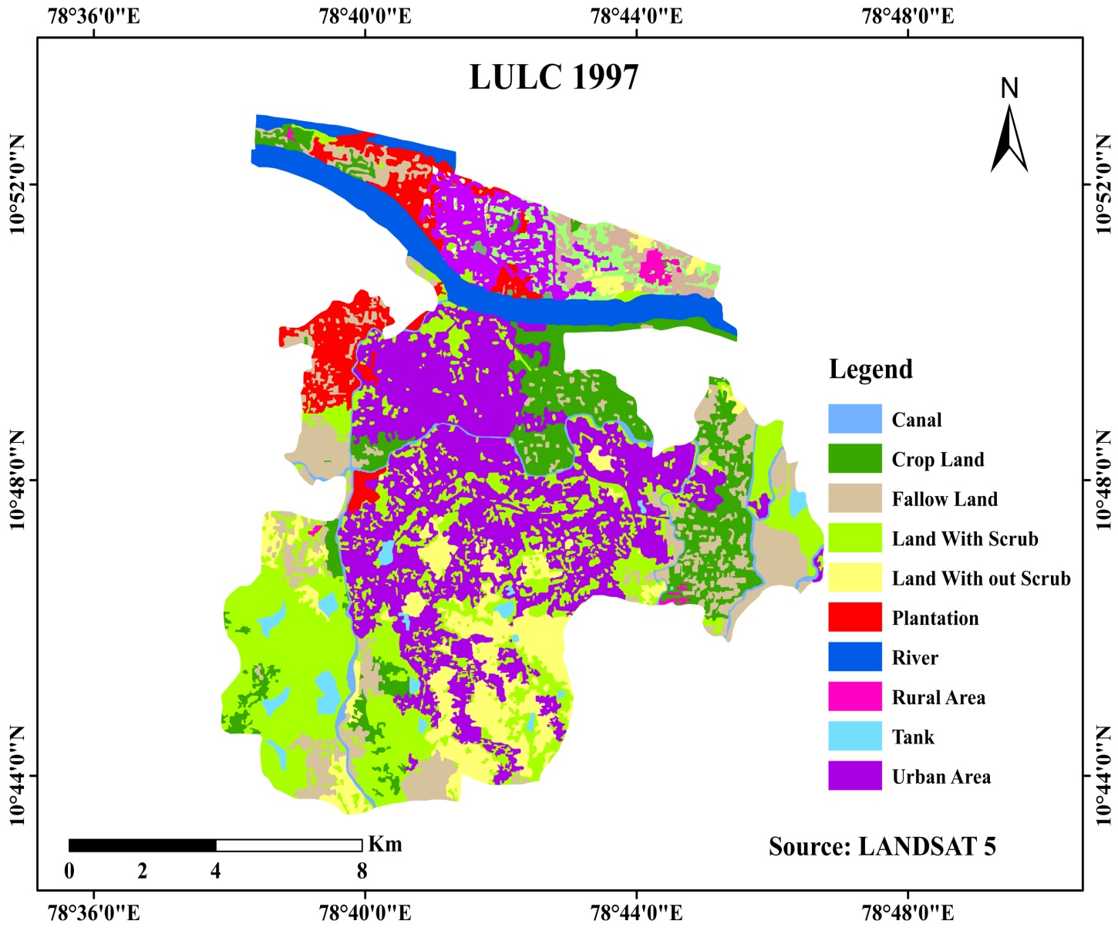
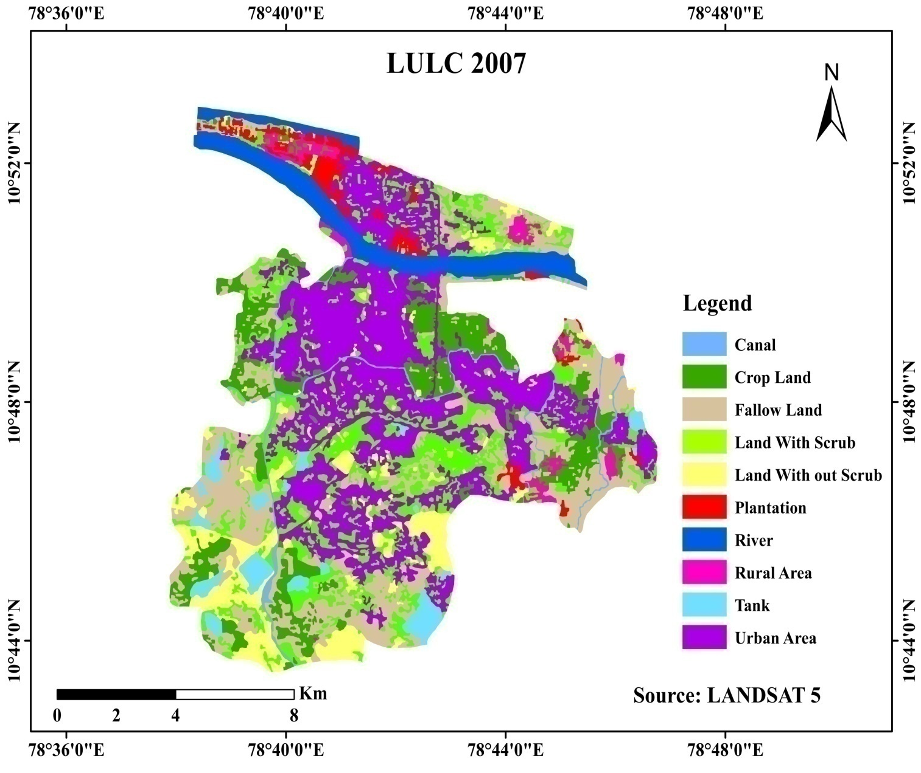
LANDUSE AND LAND COVER MAP

Slide 11
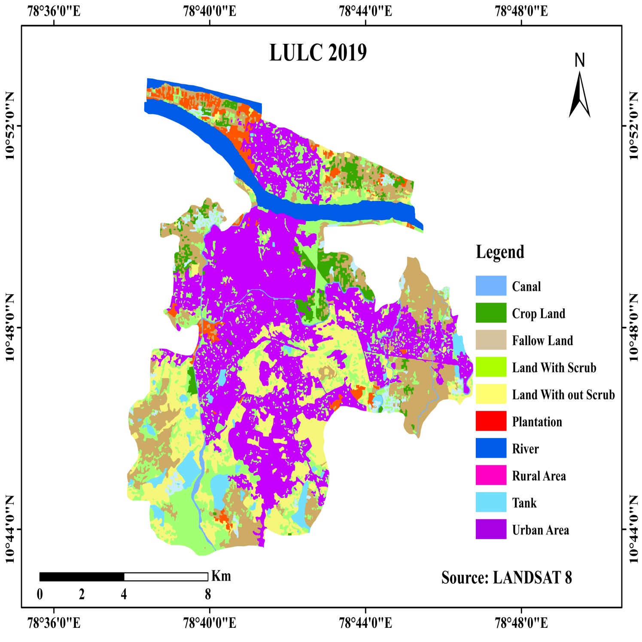

Slide 12
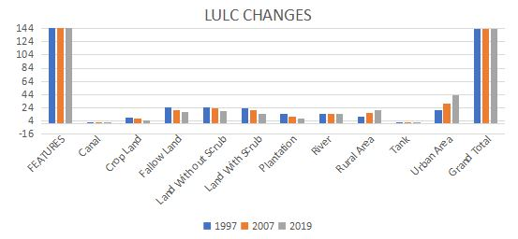
Temporal Changes in LULC
FEATURES | Area in sq.km
 | 1997 | 2007 | 2019
Canal | 1.5 | 1.5 | 1
Crop Land | 8.5 | 7 | 5
Fallow Land | 25 | 20 | 18
Land With out Scrub | 25 | 23 | 19
Land With Scrub | 23 | 20 | 15
Plantation | 15 | 10 | 8
River | 15 | 15 | 14.5
Rural Area | 10 | 16.5 | 20
Tank | 1 | 1 | 0.5
Urban Area | 20 | 30 | 43
Grand Total | 144 | 144 | 144

Slide 13
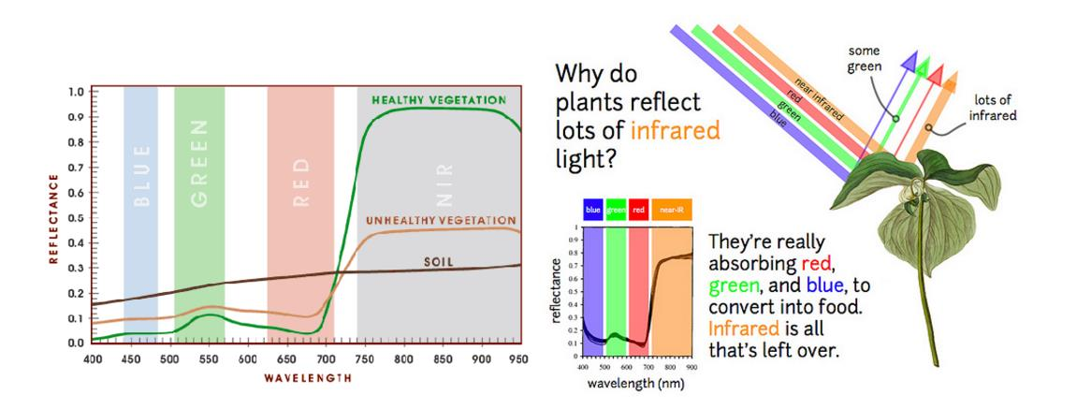
NORMALISED DIFFERENCE VEGETATION INDEX (NDVI)
Normalized Difference Vegetation Index (NDVI) quantifies vegetation by measuring the difference between near-infrared (which vegetation strongly reflects) and red light (which vegetation absorbs).
(NIR - Red)
NDVI = -----------------
(NIR + Red)
Healthy vegetation (chlorophyll) reflects more near-infrared (NIR) and
green light compared to other wavelengths. But it absorbs more red and
blue light.

Slide 14
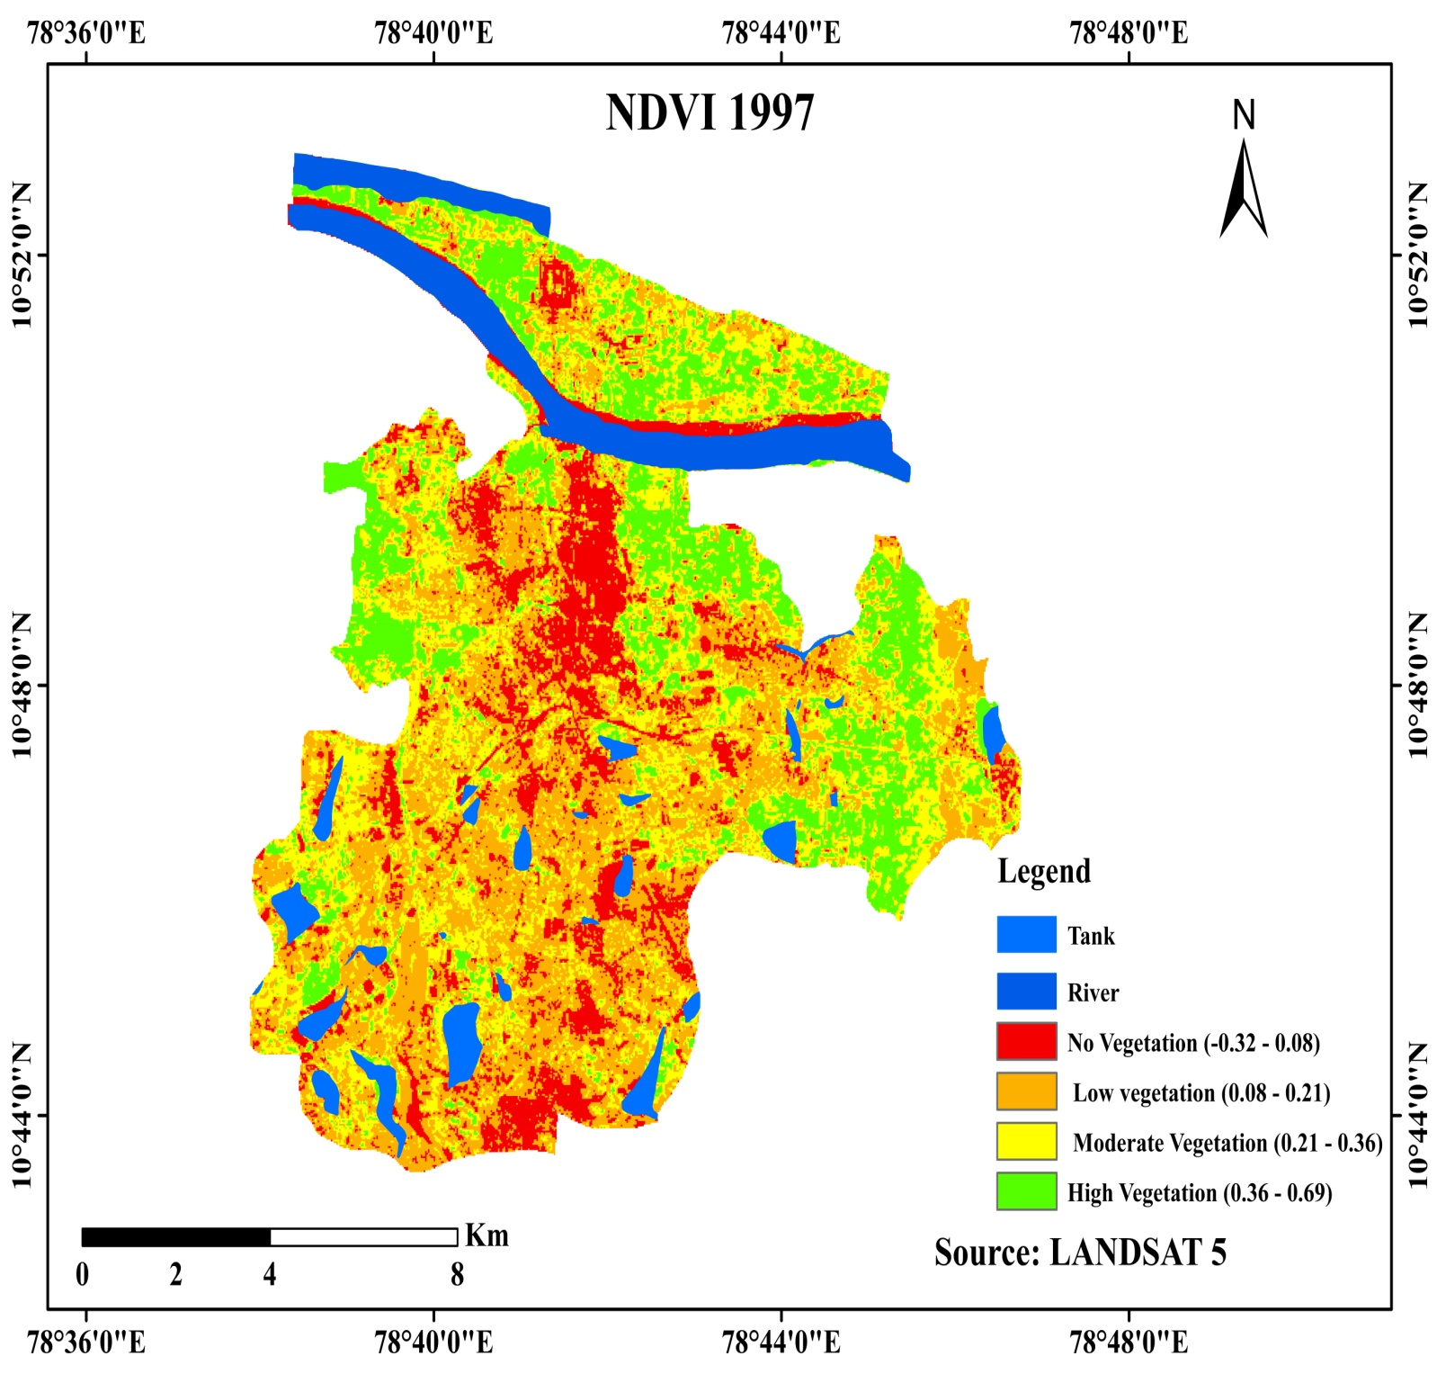
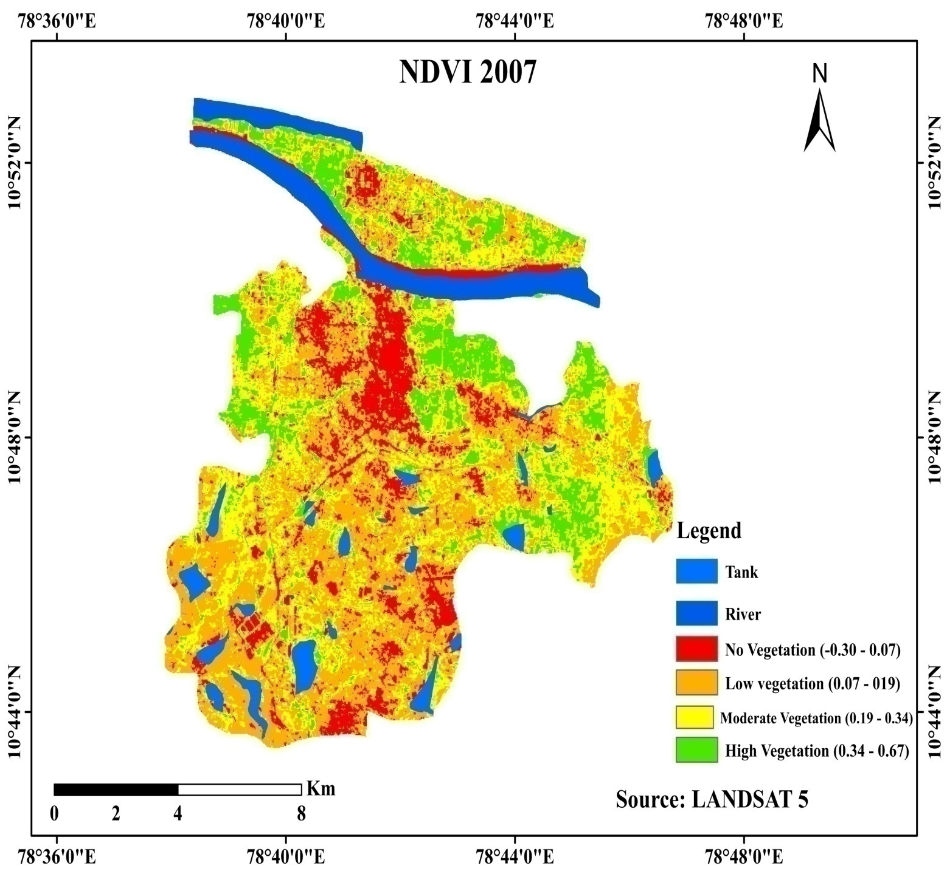

Slide 15
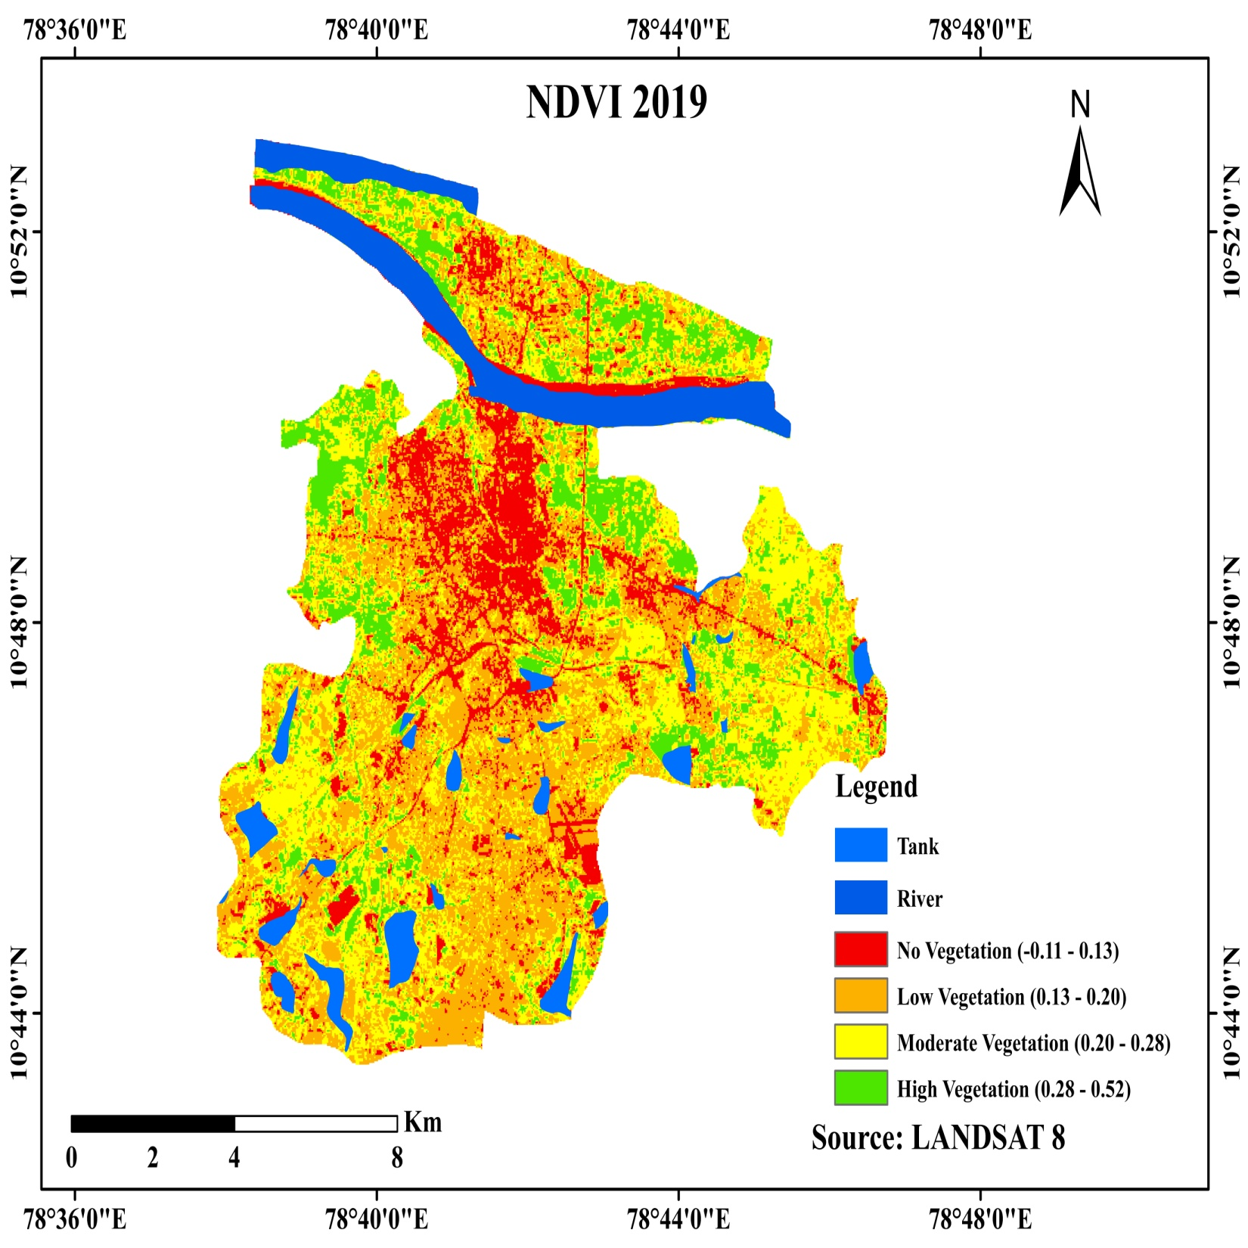

Slide 16
LAND SURFACE TEMPERATURE
To calculate the temperature , split-window algorithm was used; the steps involved are
Step-1: Convert the DN value to spectral radiance,
Step-2: Spectral radiance into temperature in Kelvin,
Step-3: Kelvin in temperature to Celsius.
QGIS (Raster calculator) was used to carry out the LST extraction

Slide 17
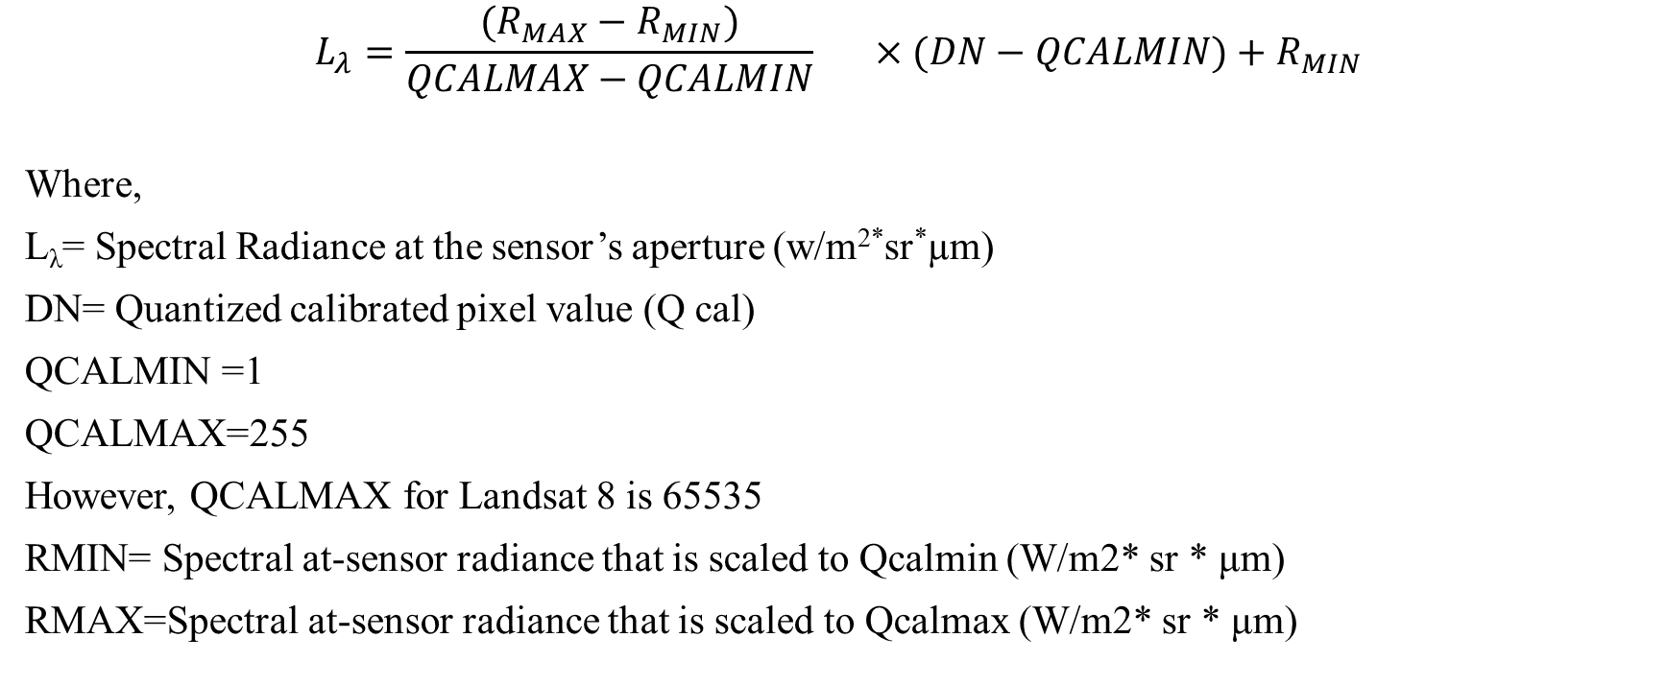
Conversion Of DN Value To Spectral Radiance

Slide 18
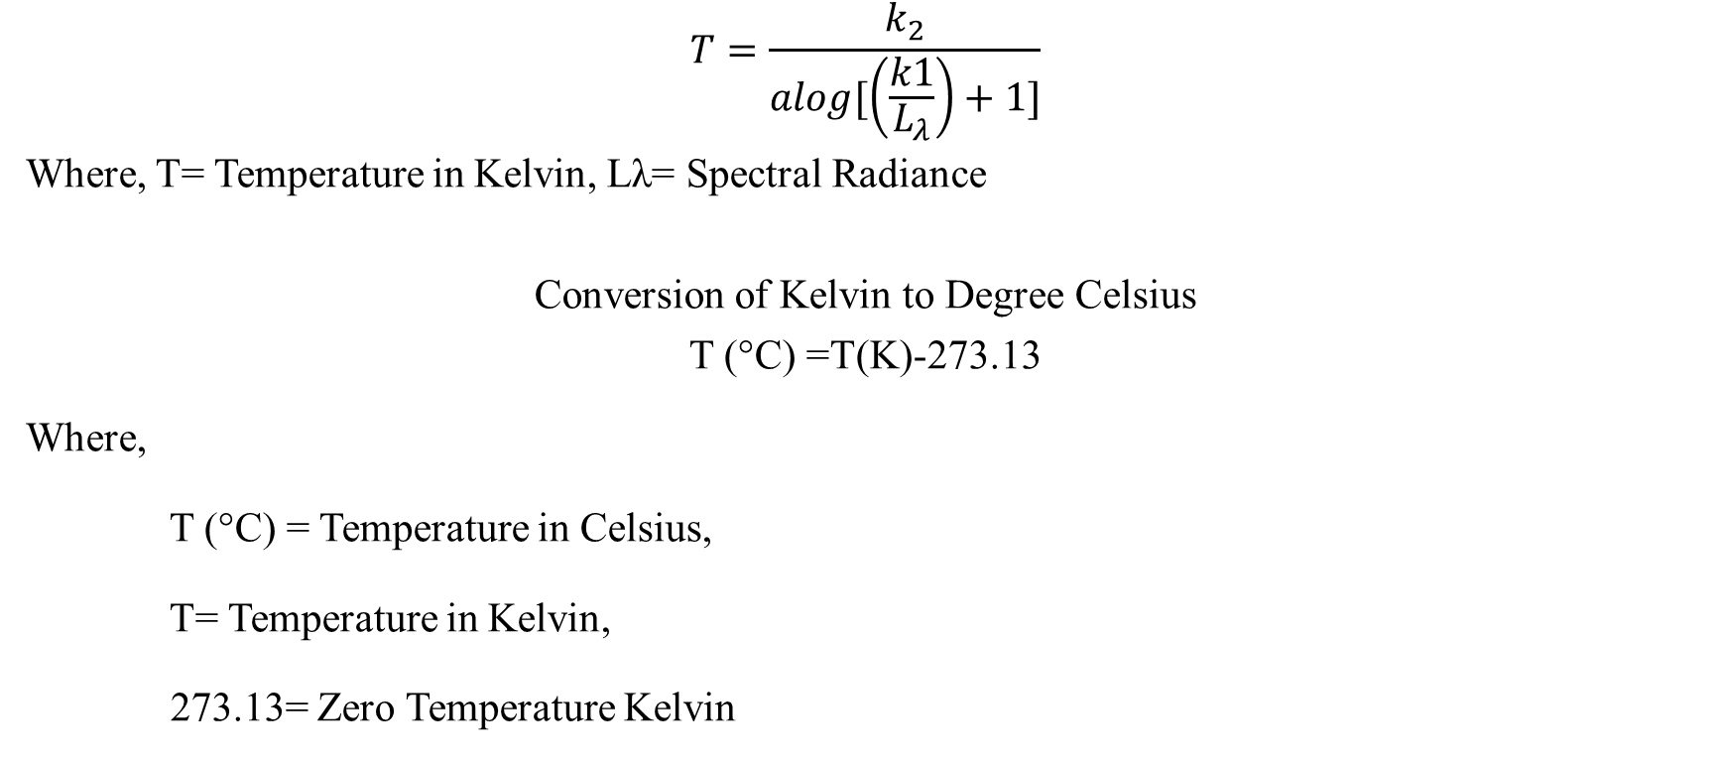
Conversion of Spectral Reflectance into Kelvin (Brightness in Temperature estimation)

Slide 19
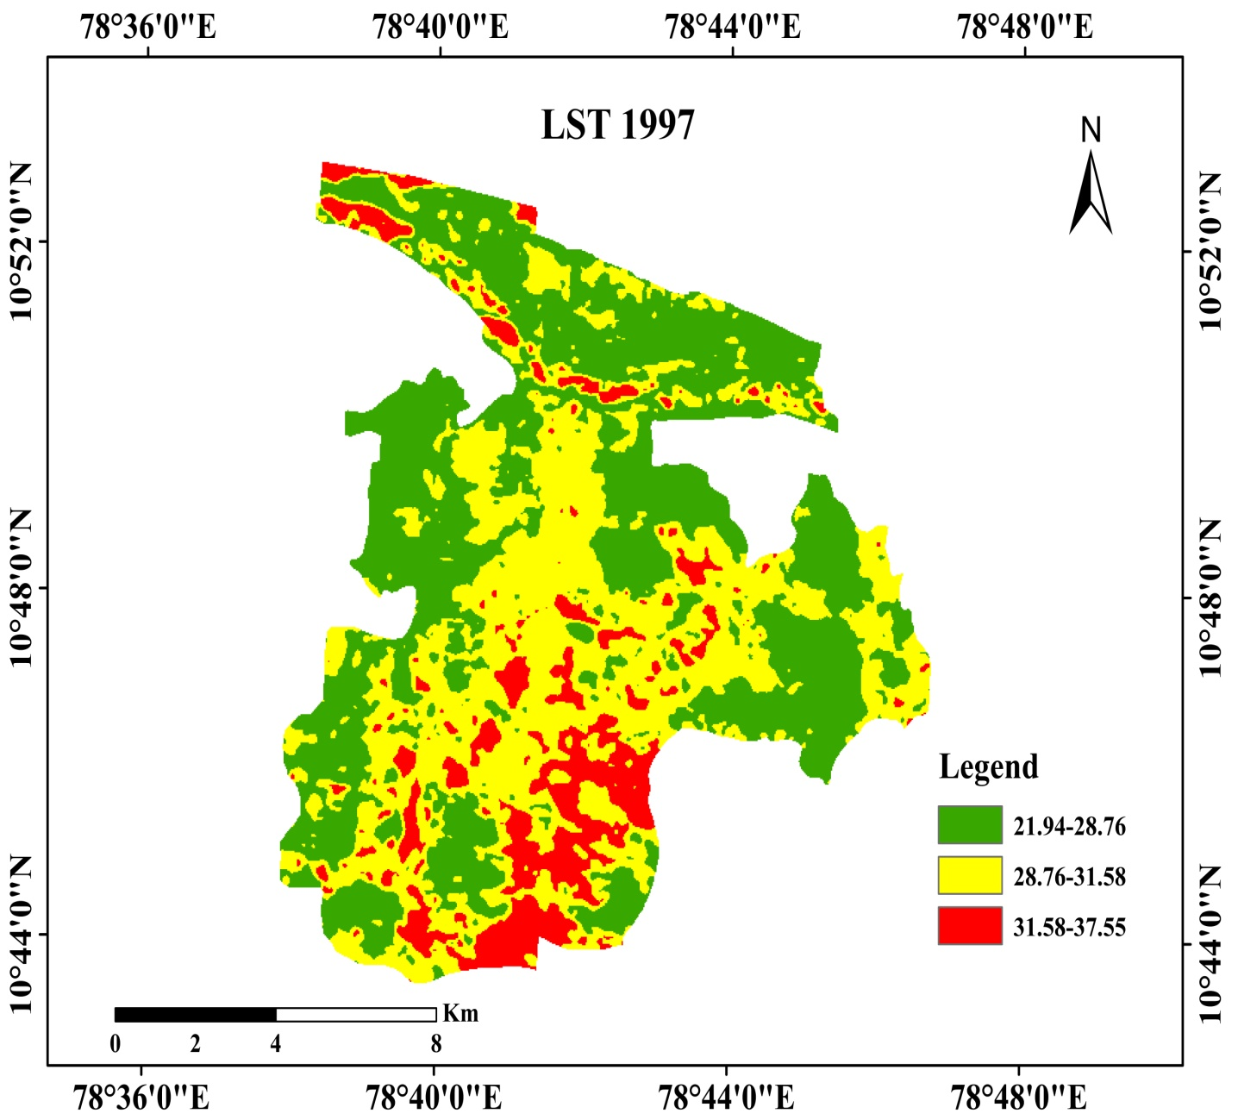
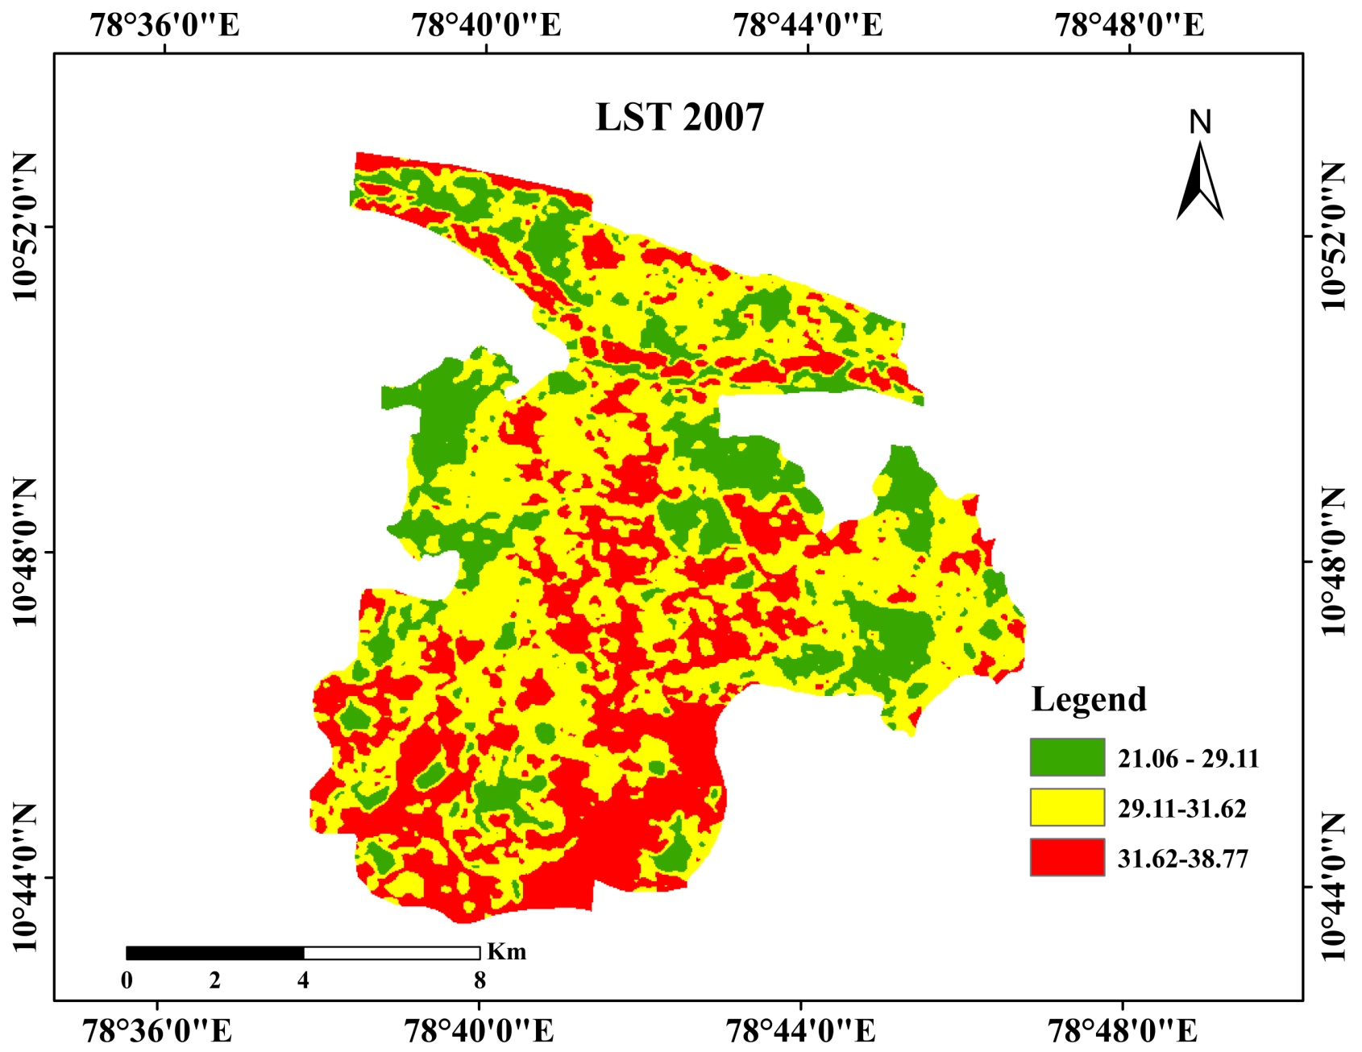

Slide 20
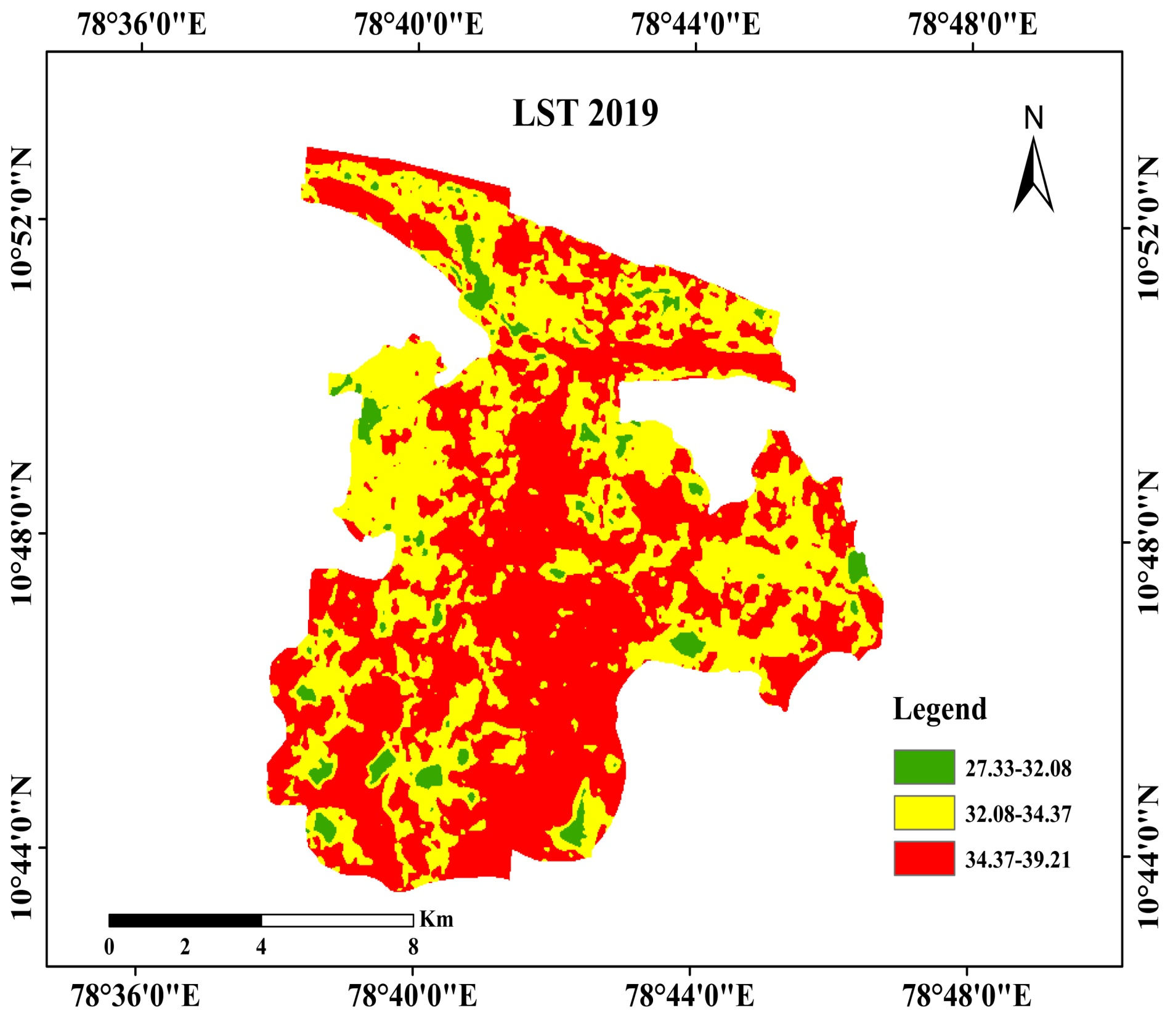

Slide 21
TEMPERATURE COMPARISON
YEAR | TEMPERATURE RANGE | AVERAGE | DIFFERENCE(FROM 1997)
1997 | 21.9419-37.6121° C | 30.1° C | 0° C
2007 | 21.0618-38.77547° C | 30.54° C | 0.54° C
2019 | 27.3320-39.21971° C | 33.95° C | 3.95° C

Slide 22
Normalized Differential Build-up Index (NDBI)
NIR-SWIR/NIR+SWIR
Where,
NIR – Near Infrared
SWIR – Short Wave Infrared

Slide 23
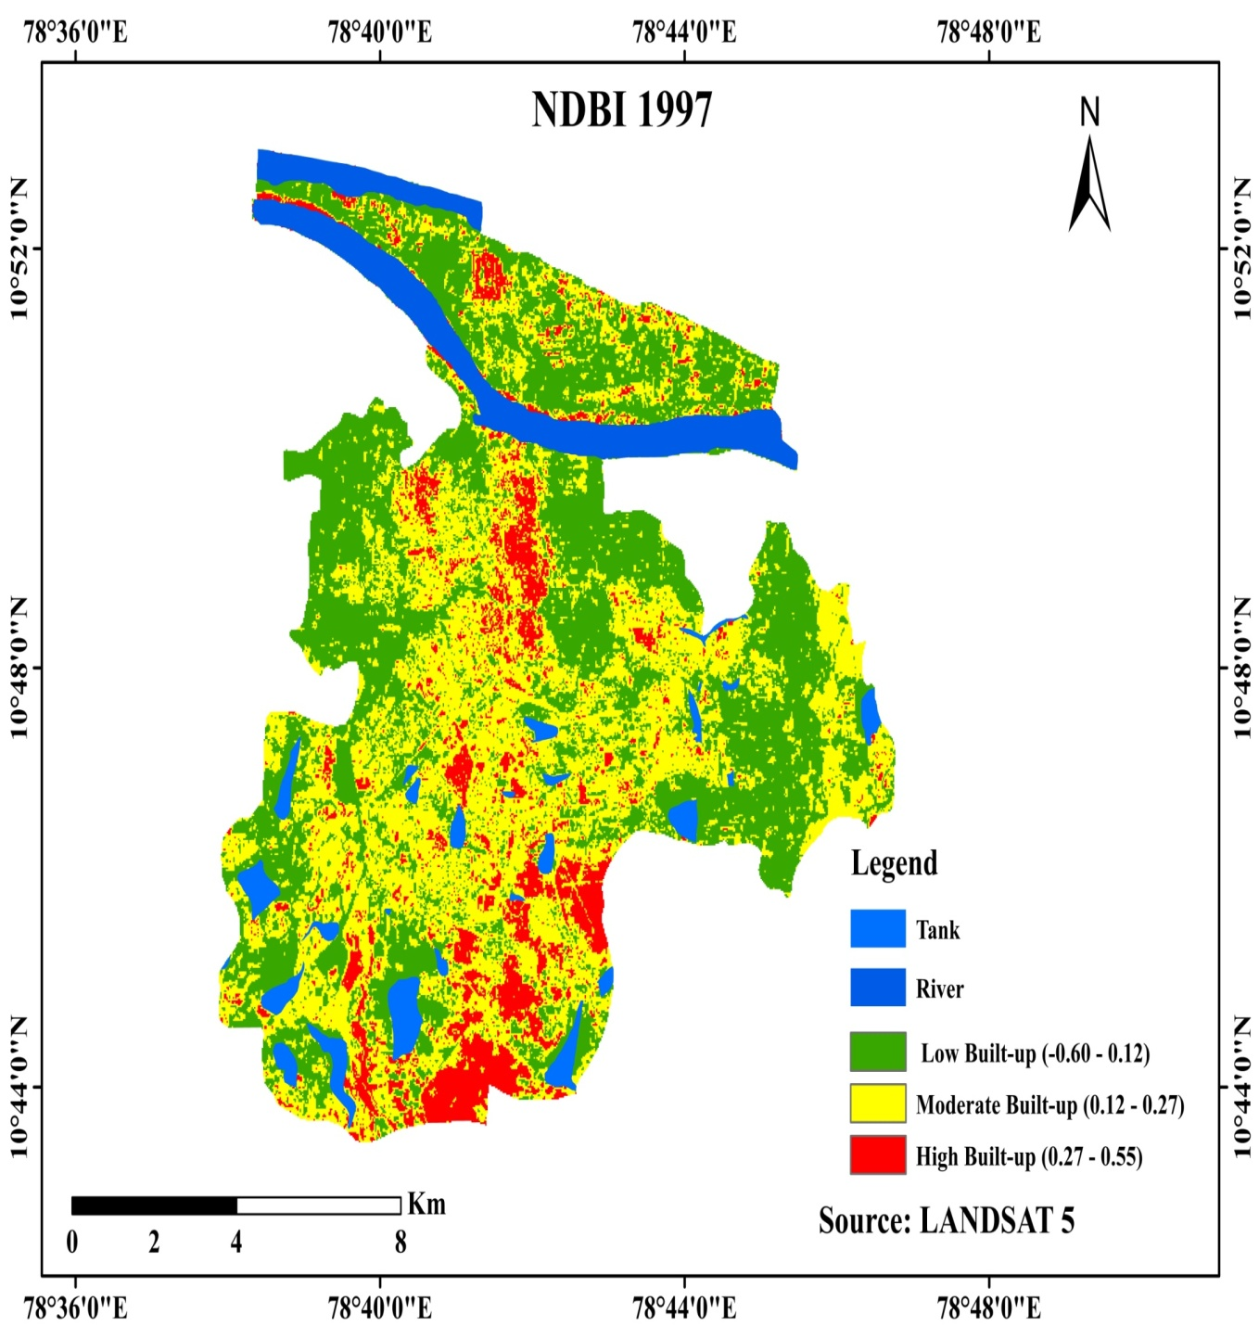
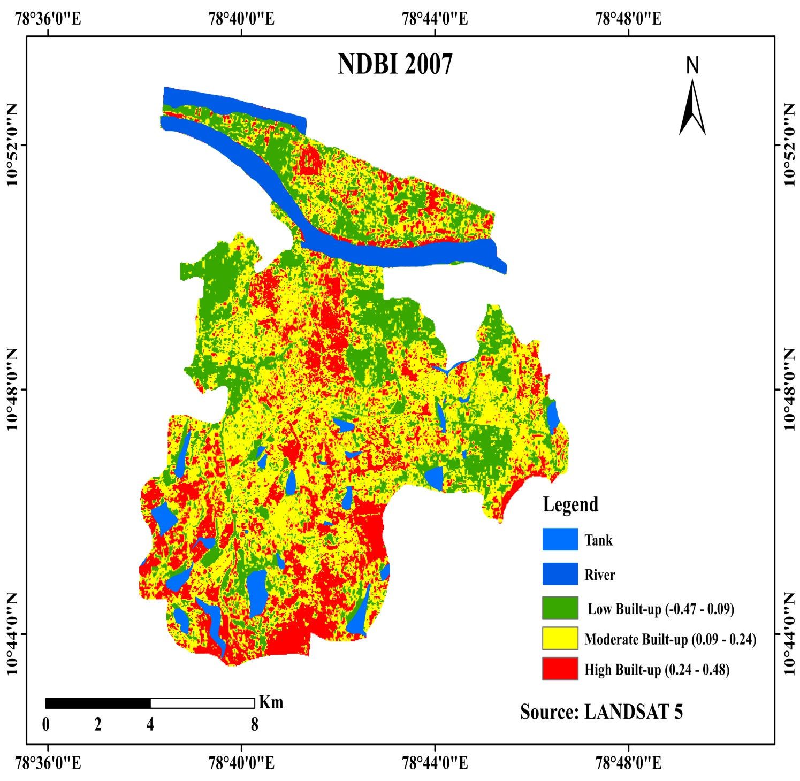

Slide 24
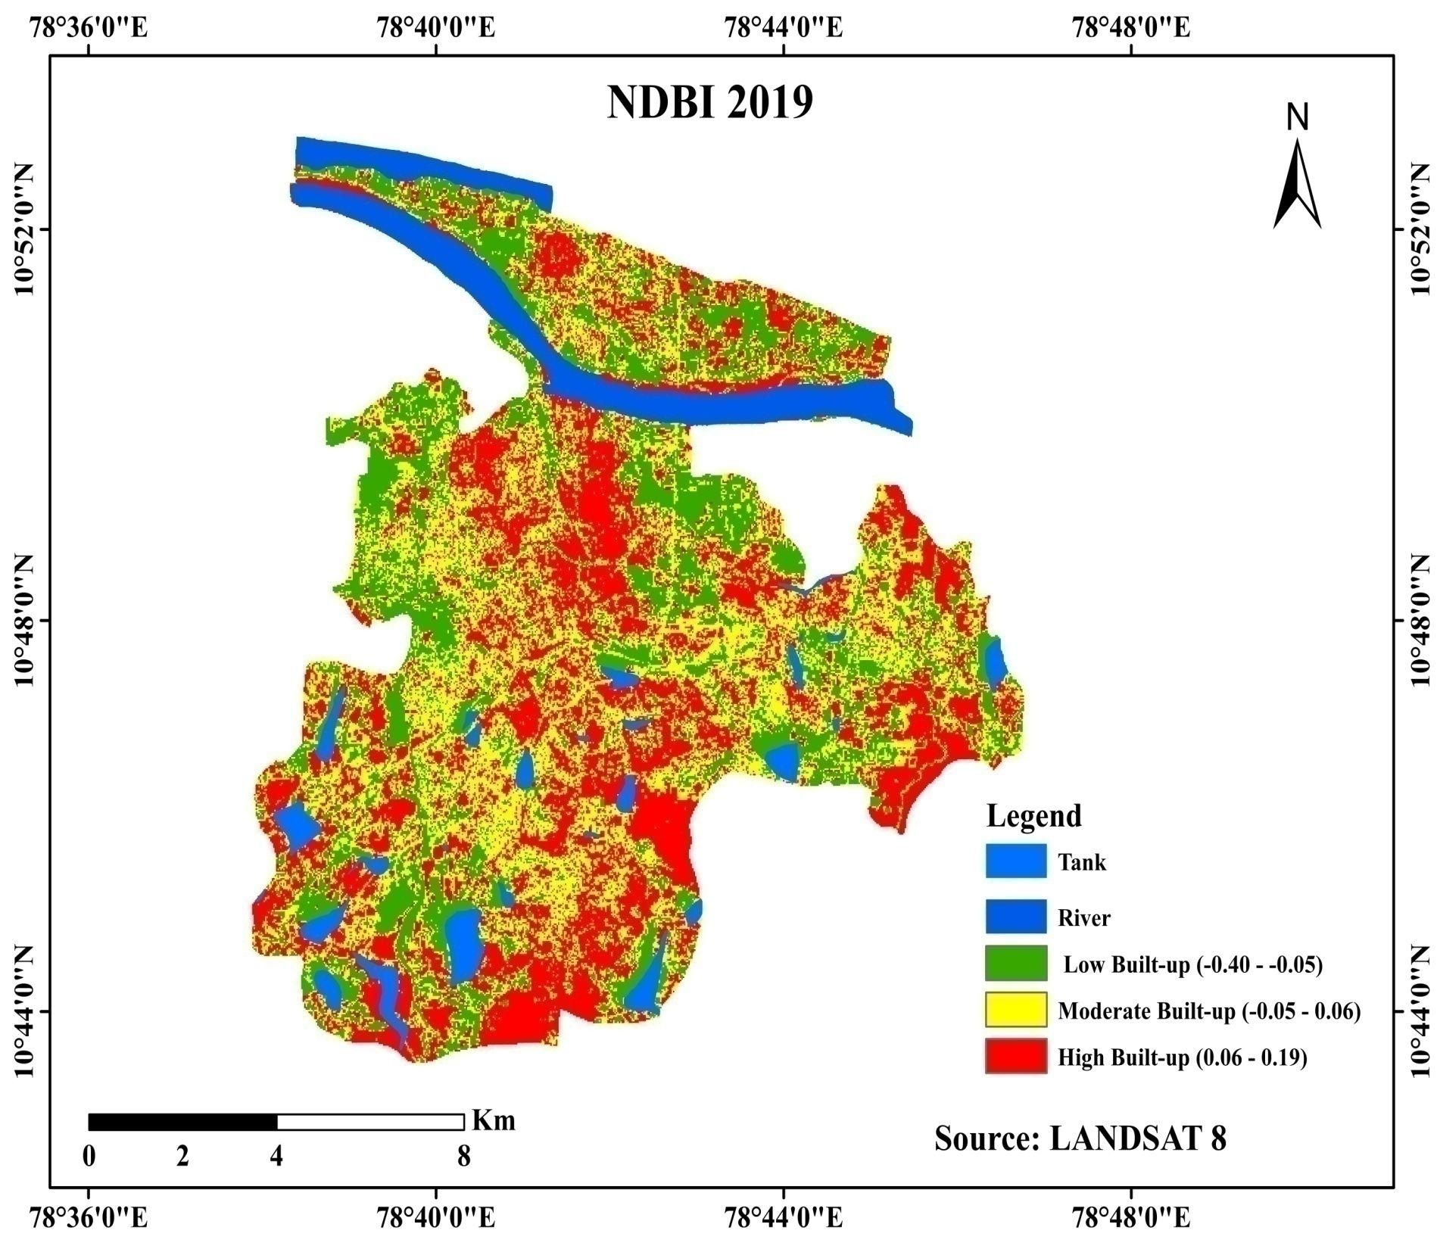

Slide 25
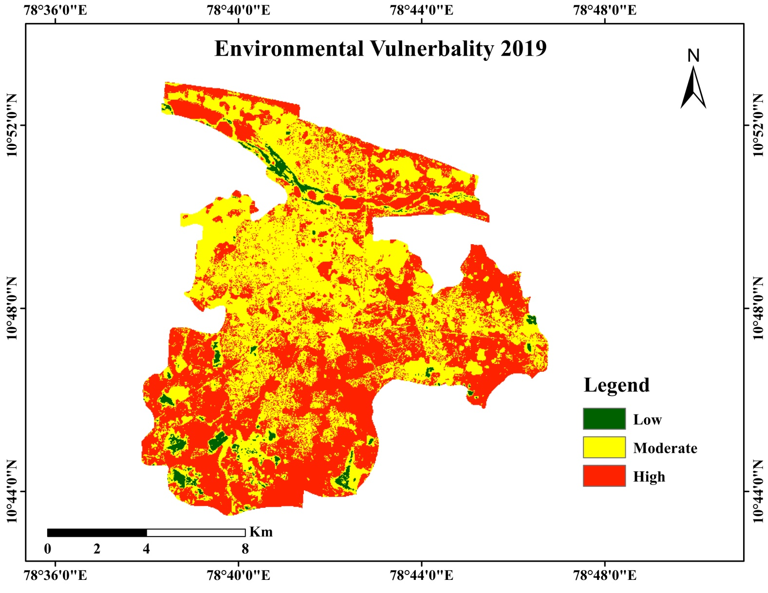
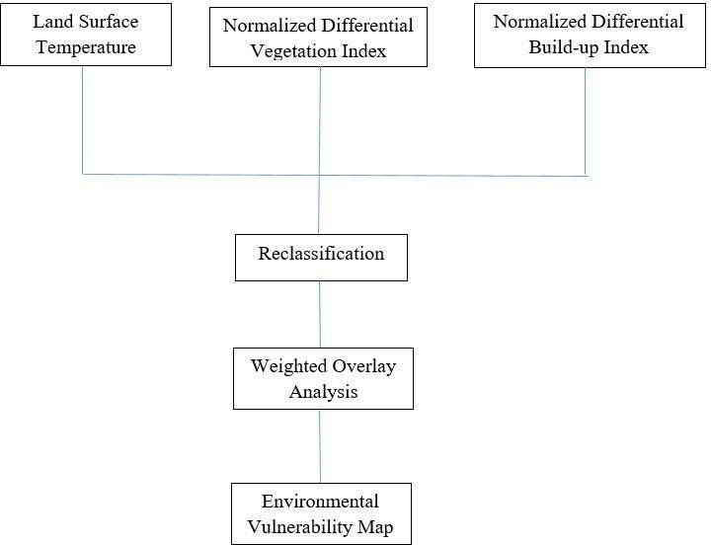
Flow chart Methodology for EVM

Slide 26
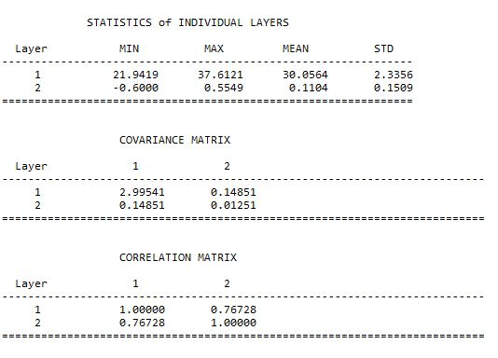
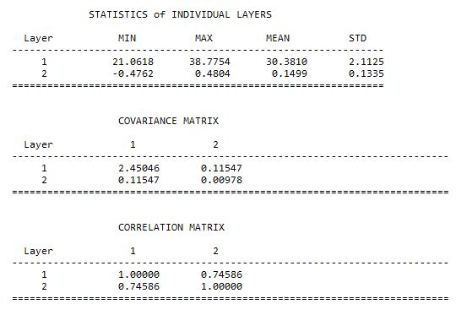
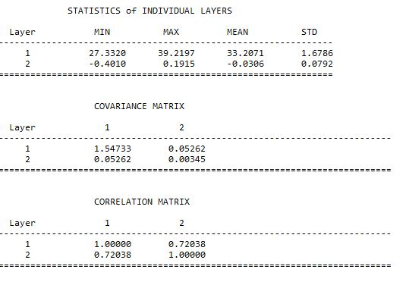
CORRELATION (LST-NDBI)
1997
2007
2019

Slide 27
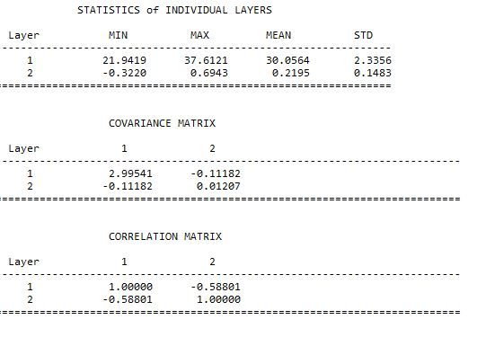
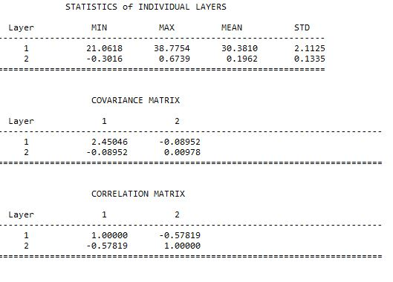
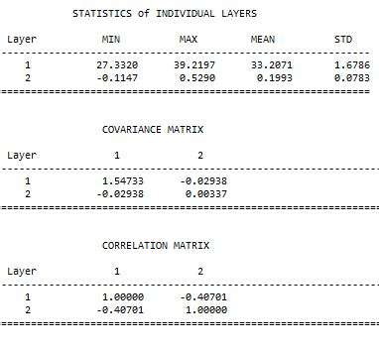
CORRELATION (LST-NDVI)
2007
2019
1997

Slide 28
Findings
Our findings reveals that correlation between LST and NDVI is negative, as already known from many other studies. LST was found to be very sensitive to vegetation and humidity.
The result shows that correlation between the vegetative cover and radiance temperature is negative.
The LU/LC changes occurred over two decades was also illustrated approximately. The buildup area has drastically increased about 24% over the years when compared with the vegetation cover which has been decreased about 25%.
The LST map generates that radiance temperature that increases about 3.95ºC in 2019 when compared with the year of 1997 & 2007. NDVI shows proportion of vegetative cover and NDBI shows buildup index effectively.
The correlation between LST, NDVI and NDBI results in high surface temperature in built up area and bare surfaces, whereas low surface temperature in vegetative areas.
Environmental vulnerability map shows that the radiance temperature variability as a result of urbanization and decreases in vegetation.

Slide 29
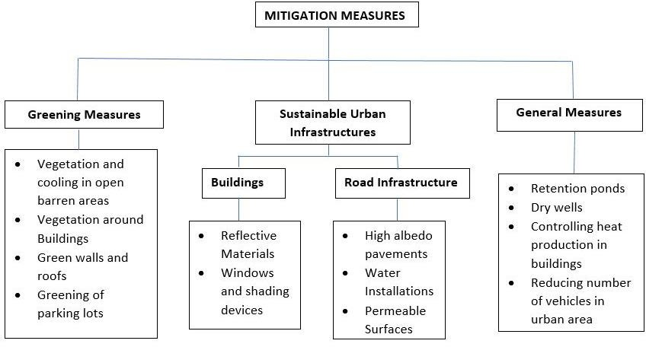
MITIGATION MEASURES

Slide 30
SITE SELECTION FOR SOLID WASTE MANAGEMENT
The manual analysis of solid waste management is very tedious as it involves a huge data and statistics.
Geographical Information System (GIS) is a tool introduced to overcome these limitations and make waste management planning to be more efficient and also can be quickly implemented.
It will reduce the waste management work load to a great extent. The present study aims at selecting suitable sites for solid waste in Tiruchirappalli city.
The various data like Road map, Slope map, land use /land cover map, Road & river buffers were created. They were digitized using QGIS and weighted overlay was carried out to find suitable sites for dumping solid waste.

Slide 31
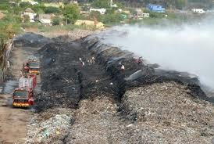
EXISTING SOLID WASTE DISPOSAL SITE
The estimated MSW generation in Trichy city is about 400 to 600 tons per day, which is facilitated by an open dumping yard namely Ariyamangalam garbage ground.
The dumping site is positioned at 10˚48’N and 78˚43’E. Inappropriate disposal of solid waste can be manifested by soil contamination through direct waste contact, air pollution by burning of wastes, spreading of diseases by different vectors like birds, insects and rodents, or uncontrolled release of methane by anaerobic decomposition of waste.
The unscientific landfill may reduce the quality of the drinking water by contamination of surface and ground water through leachate and causes diseases like jaundice, nausea, asthma.
Therefore, locating proper sites for solid waste disposal and selecting appropriate landfill site far from residential areas, environmental resources and settlement is very important for the management of solid waste.

Slide 32
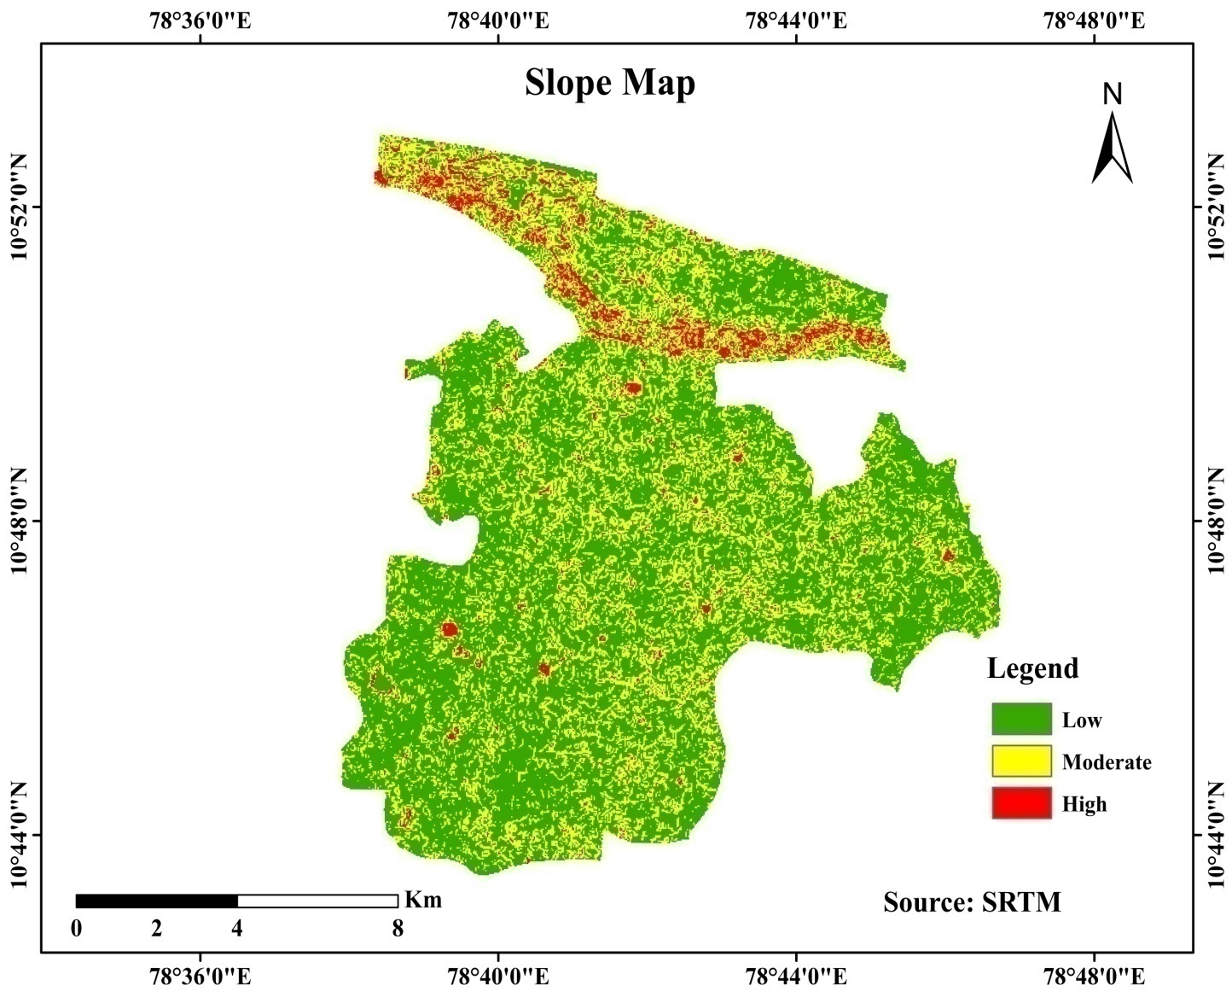
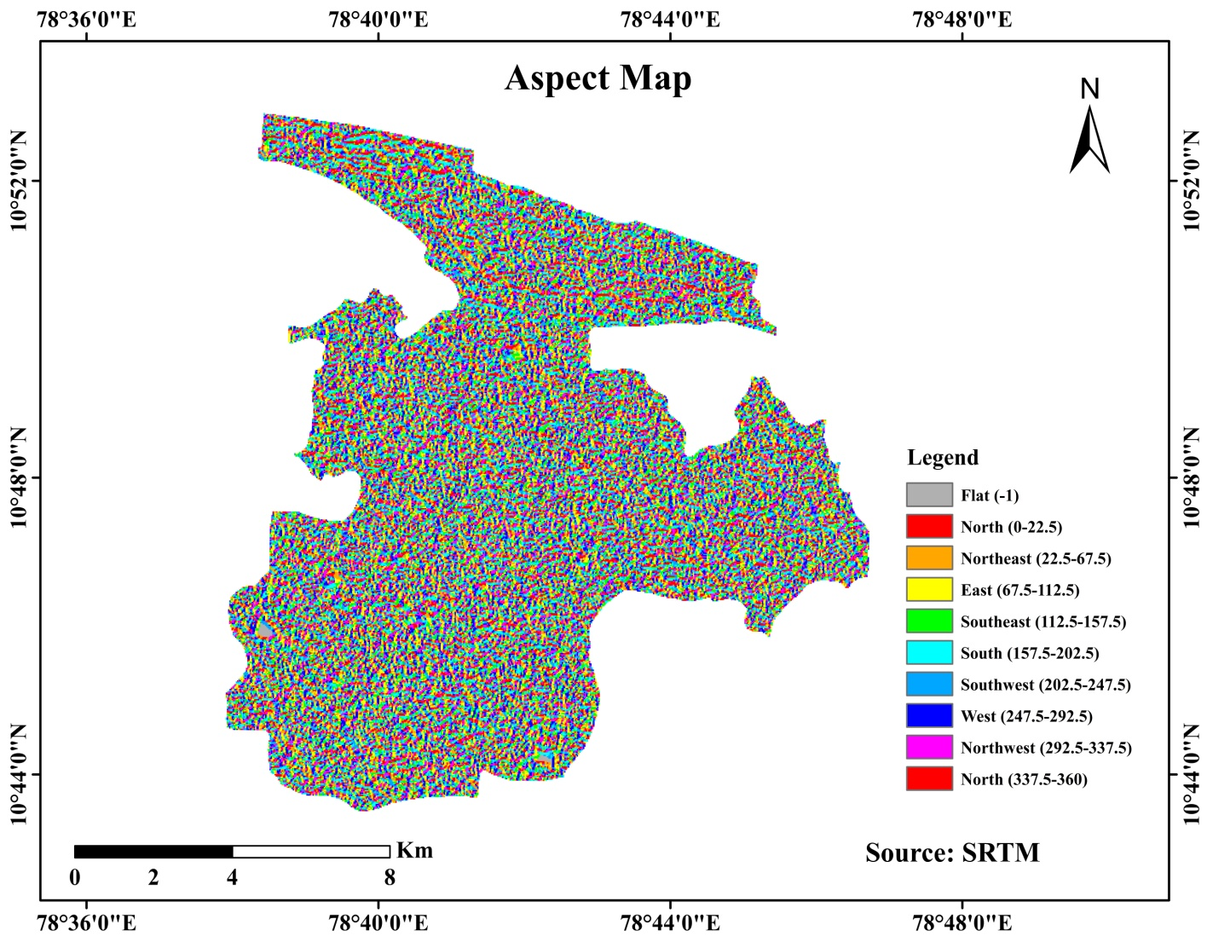
THEMATIC MAPS

Slide 33
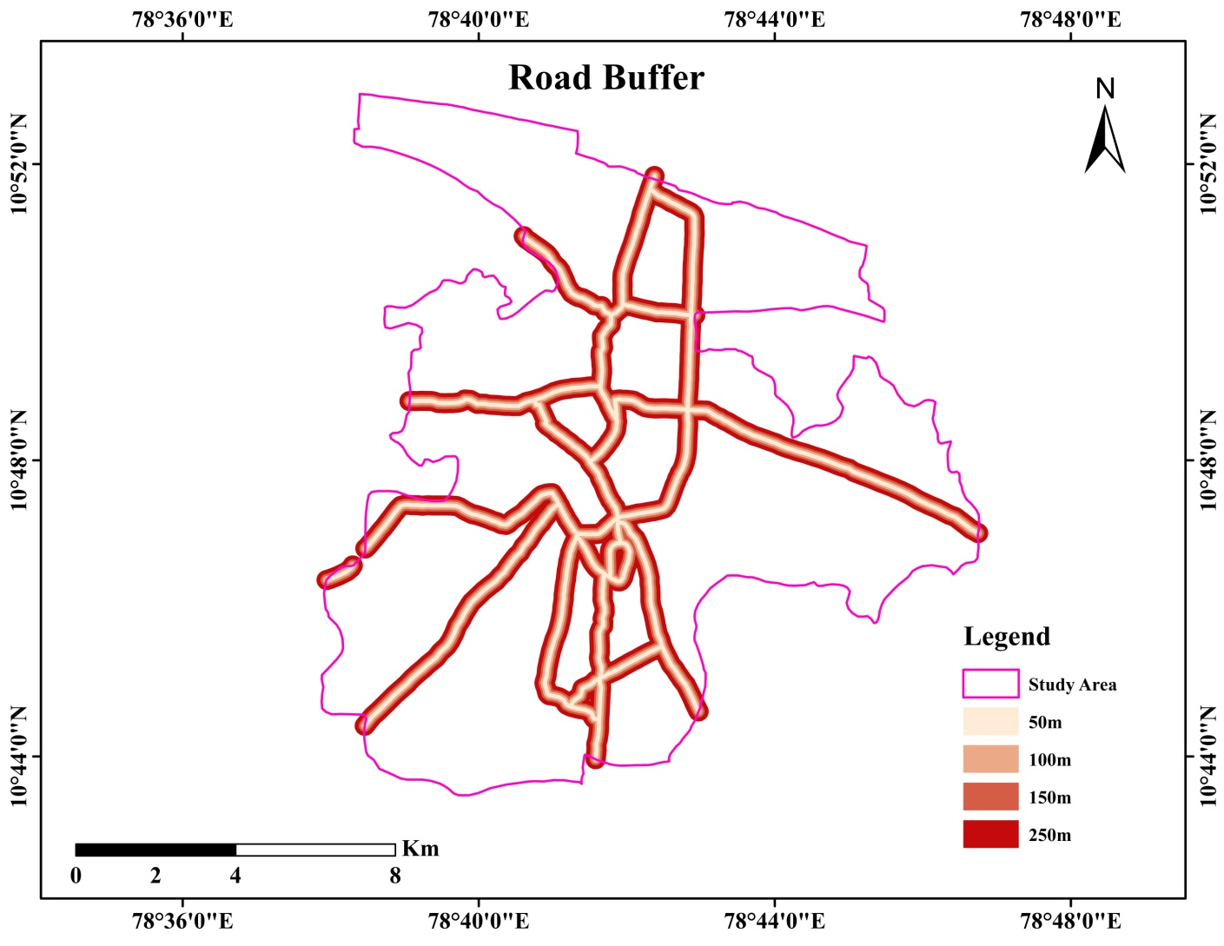
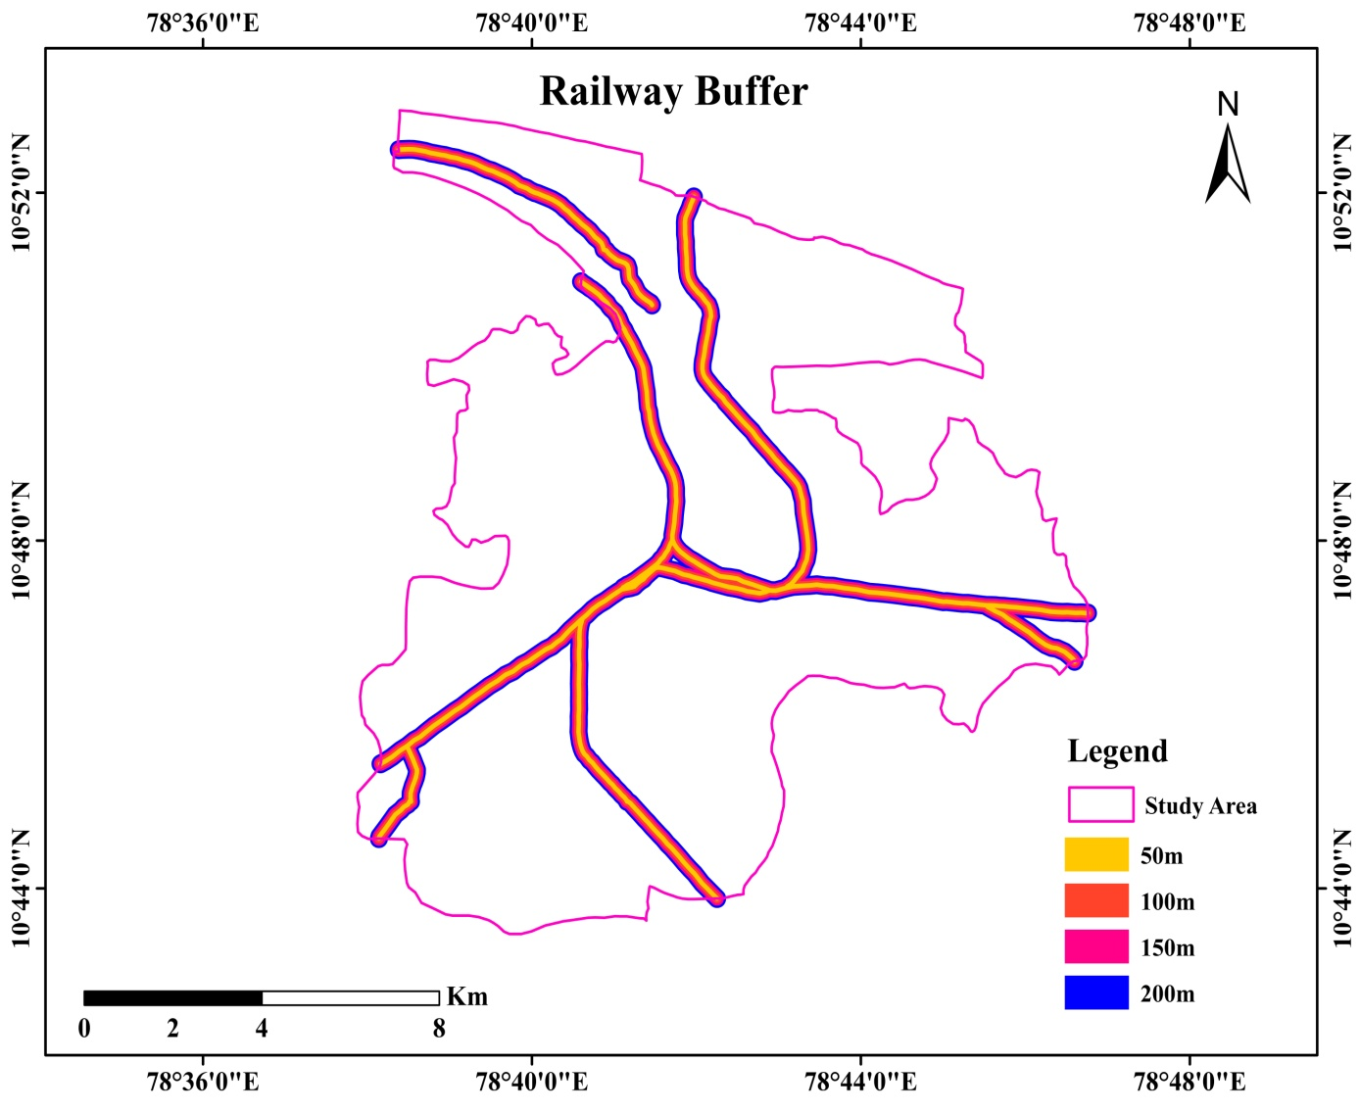
ROAD & RAILWAY NETWORK BUFFER ZONES

Slide 34
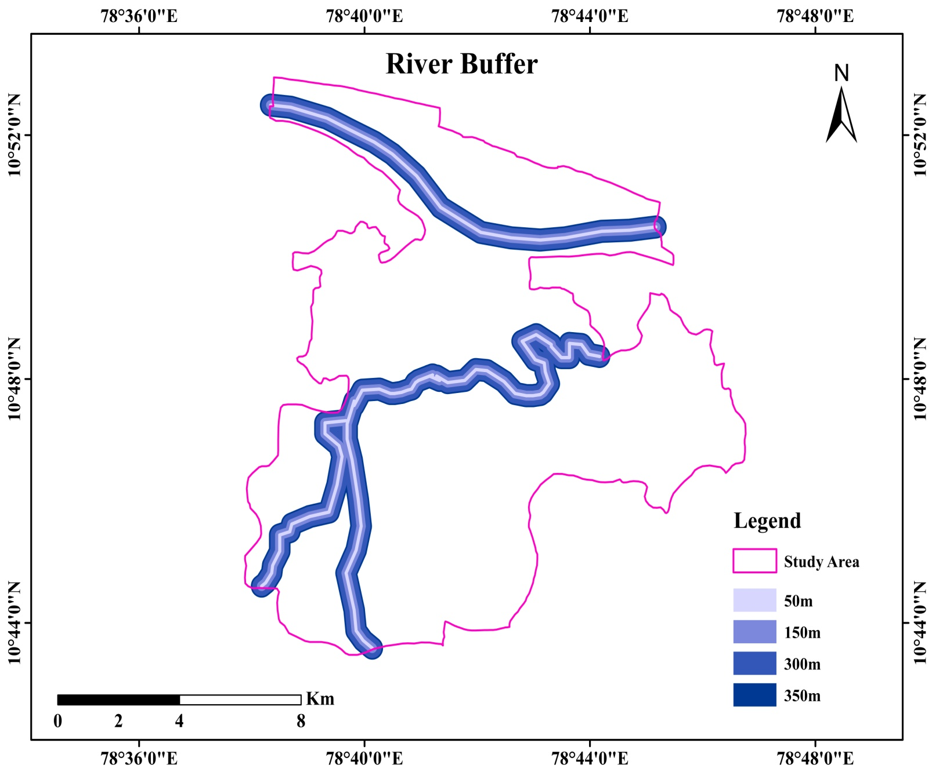

Slide 35
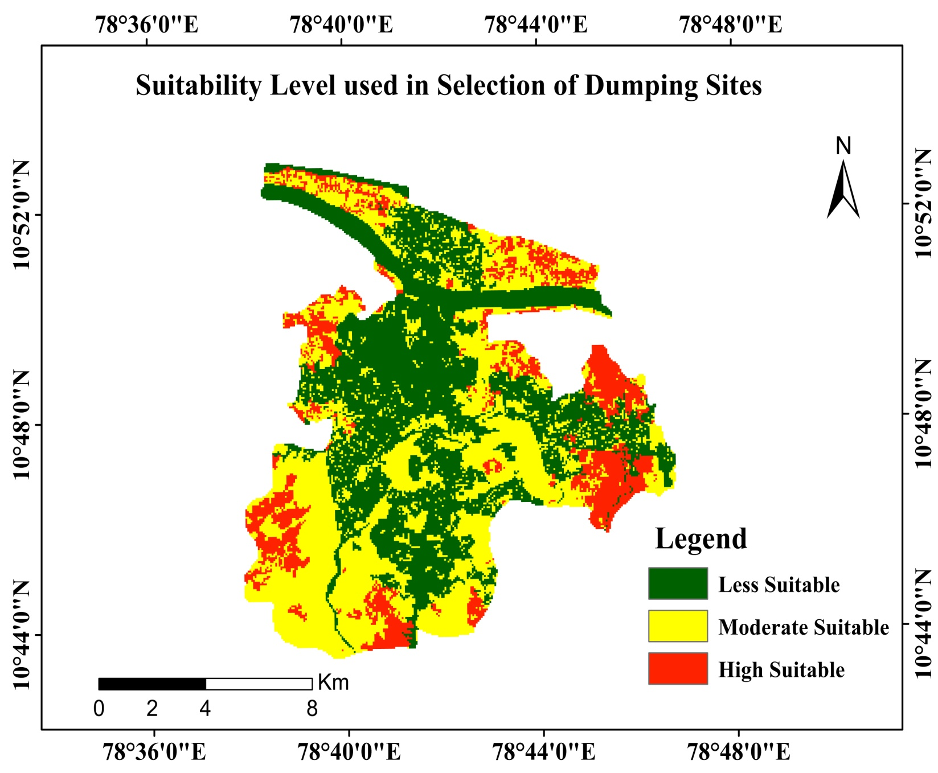
Final suitability map for site selection
S.No | Criteria | Weights | Priority Percentage
1 | Slope | 15 | 17.93
2 | Geology | 15 | 12.25
3 | Landuse & Land cover | 30 | 42.23
4 | Distance from road | 20 | 13.5
5 | Distance from main river | 20 | 14.09
Total |  | 100 | 100

Slide 36
CONCLUSION
Solid wastes consist of highly heterogeneous mass of discarded materials from residential, commercial and industrial activities.
Selection of disposal sites for solid wastes generated in the urban area has always remained a big task as the selected site should not affect the environment negatively.
The methodology employed in this study described the QGIS and weighted index process techniques for the selection of suitable sites for the disposal of municipal solid wastes in Tiruchirappalli district.
The study shows the ability of QGIS as an authentic tool for decision support.
Finally, the suitable site was selected for the management of solid waste in the study area which was identified to be the ideal and the most accessible site.

Slide 37
REFERENCES
[1].Analysis of Urban Heat Island (UHI) in Relation to Normalized Difference Vegetation Index (NDVI): A Comparative Study of Delhi and Mumbai -Aakriti Grover and Ram Babu Singh.
[2]. Ankitverma and BhondeB.K,”Optimization of municipal solid waste management of Indore city using GIS “International journal on emerging technologies: 194-200 (2014)
[3]. Karthiheyan P.N and Yeshodha L “Site selection for urban solid waste disposal using remote sensing and open source GIS in krishnagiri district, Tamil nadu” International journal for innovative research in Science & technology ,vol 2,Issue 10,march 2016:2349-6010
[4]. Kallel, Amjad, Mohamed MoncefSerbaji, and MoncefZairi. "Using GIS-Based Tools for the Optimization of Solid Waste Collection and Transport: Case Study of Sfax City, Tunisia." Journal of Engineering 2016 (2016).
[5]. Hannan, M. A., et al. "A review on technologies and their usage in solid waste monitoring and management systems: Issues and challenges." Waste Management 43 (2015): 509-523.
[6]. Şener, Şehnaz, ErhanSener, and RemziKaragüzel. "Solid waste disposal site selection with GIS and AHP methodology: a case study in Senirkent–Uluborlu (Isparta) Basin, Turkey." Environmental monitoring and assessment173.1-4 (2011): 533-554

Slide 38
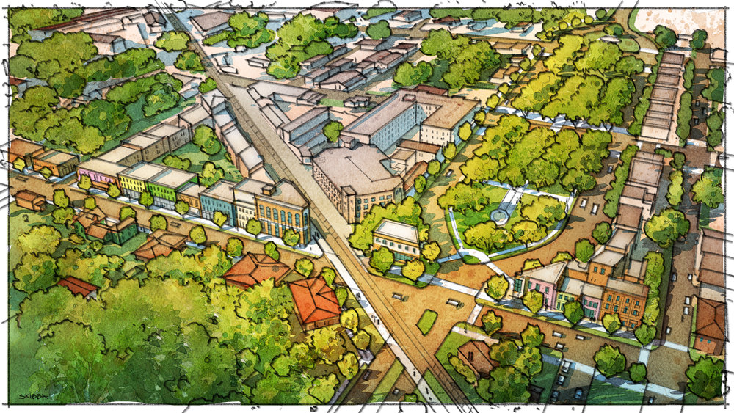
Thank you

